Slide 1
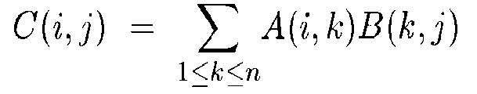
Matrix Multiplication
Direct Method:
Suppose we want to multiply two n x n matrices, A and B.
Their product, C=AB, will be an n by n matrix and will therefore have n² elements.
The number of multiplications involved in producing the product in this way is Θ(n³)

Slide 2
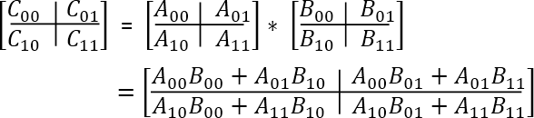
Matrix Multiplication
Divide and Conquer method for Matrix multiplication
How many Multiplications?
8 multiplications for matrices of size n/2 x n/2 and 4 additions.
Addition of two matrices takes O(n²) time. So the time complexity can be written as T(n) = 8T(n/2) + O(n²) which happen to be O(n³); same as the direct method

Slide 3

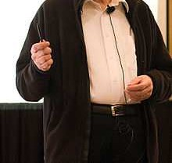
Stressen’s matrix multiplication
Multiplication of 2 × 2 matrices:
By using divide-and-conquer approach we can reduce the number of multiplications.
Such an algorithm was published by
V. Strassen in 1969.

Slide 4
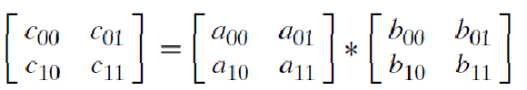
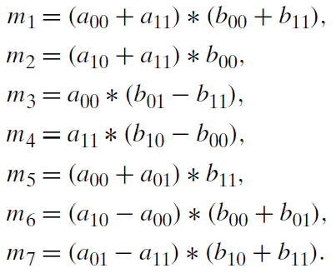
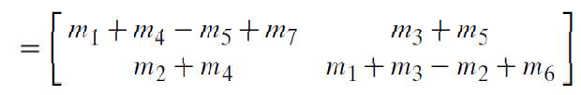
Strassen’s matrix multiplication
The principal insight of the algorithm
  product C of two 2 × 2 matrices A and B
  with just seven multiplications
This is accomplished by

Slide 5
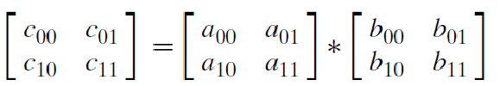
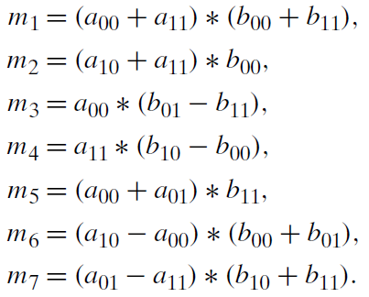
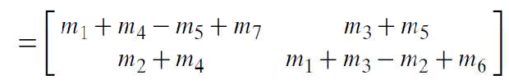
Strassen’s matrix multiplication

Slide 6
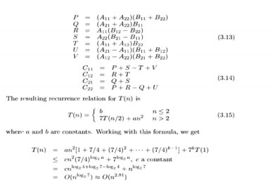

Slide 7
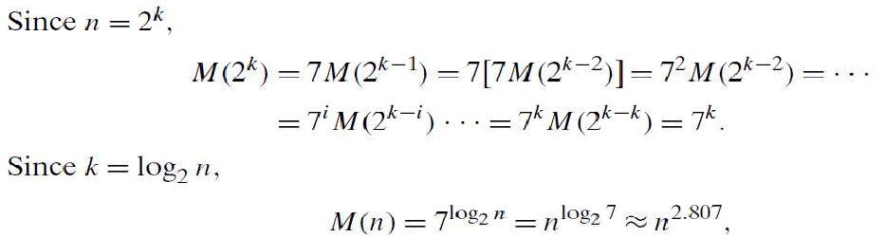
Analysis
Recurrence relation (considering only multiplication)

Slide 8
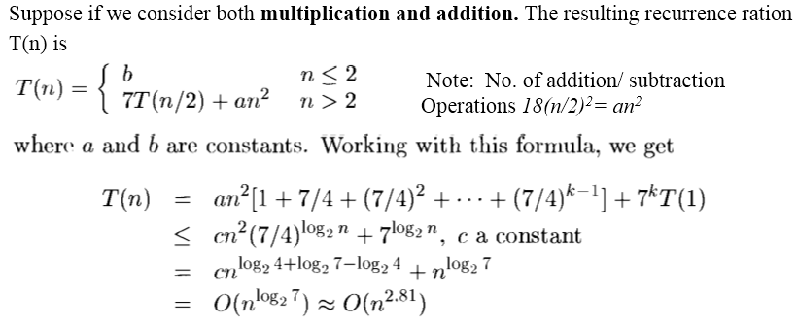
Analysis ( From T2: Horowitz et al )

Slide 9
Advantages and Disadvantages of Divide & Conquer
Parallelism: Divide and conquer algorithms tend to have a lot of inherent parallelism.
Cache Performance: Once a sub-problem fits in the cache, the standard recursive solution reuses the cached data until the sub-problem has been completely solved.
It allows solving difficult and often impossible looking problems like the Tower of Hanoi
X Recursion is slow
– sometimes it can become more complicated than a basic iterative approach, the same sub problem can occur many times. It is solved again.

Slide 10



Module 2 – Outline Divide and Conquer
General method
Recurrence equation
Algorithm: Binary search
Algorithm: Finding the maximum and minimum
Algorithm: Merge sort
Algorithm: Quick sort
Algorithm: Strassen’s matrix multiplication
Advantages and Disadvantages
Decrease and Conquer Approach
Algorithm: Topological Sort

Slide 11
Decrease and Conquer Approach
There are three major variations of decrease-and- conquer:
  decrease-by-a-constant, most often by one (e.g., insertion sort)
  decrease-by-a-constant-factor, most often by the factor of two (e.g., binary search)
  variable-size-decrease (e.g., Euclid’s algorithm)

Slide 12
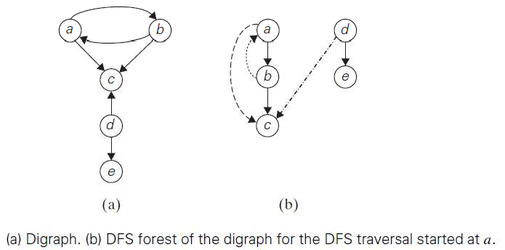
Topologocal Sorting
Graph, Digraph
Adjacency matrix and adjacency list
DFS, BFS

Slide 13
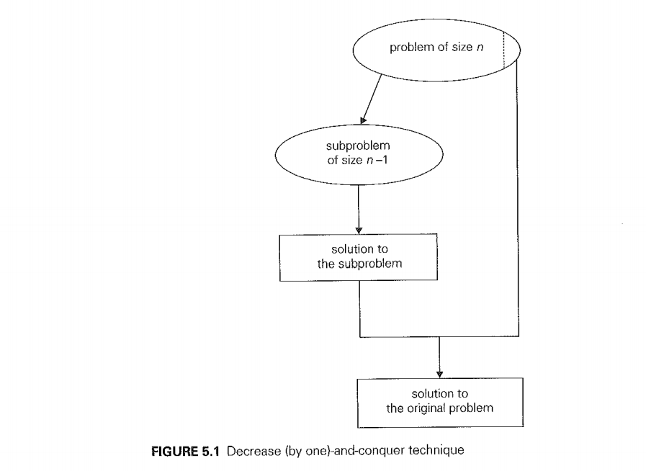

Slide 14
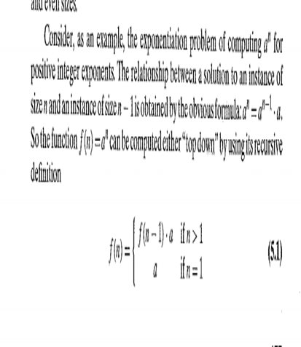

Slide 15
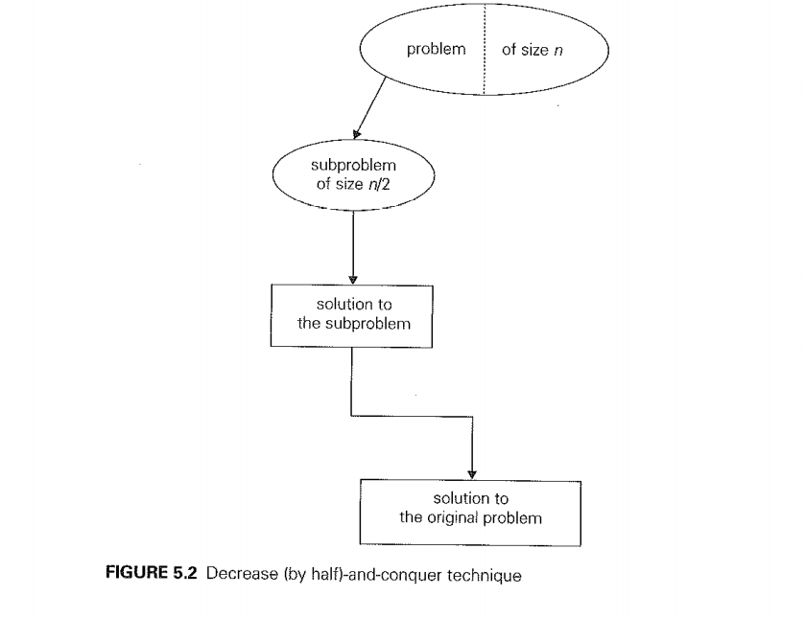

Slide 16
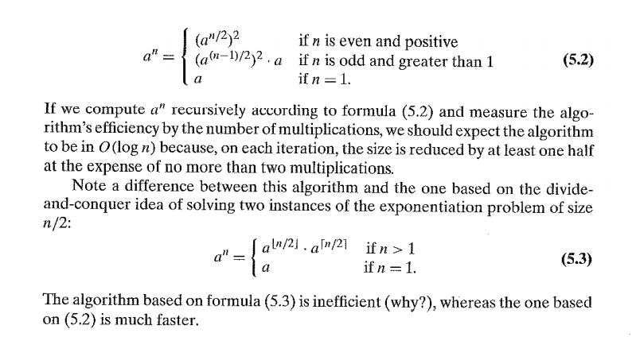

Slide 17
Tree Edge: It is an edge which is present in the tree obtained after applying DFS on the graph ab,bc,de.
Forward Edge: It is an edge (u, v) such that v is descendant but not part of the DFS tree. ac
Back edge: It is an edge (u, v) such that v is ancestor of node u but not part of DFS tree. ba
. Presence of back edge indicates a cycle in directed graph.
Cross Edge: It is a edge which connects two node such that they do not have any ancestor and a descendant relationship between them. dc

Slide 18
Digraph
A directed cycle in a digraph is a sequence of three or more of its vertices that starts and ends with the same vertex
For example, a, b, a is a directed cycle in the digraph in Figure given above.
Conversely, if a DFS forest of a digraph has no back edges, the digraph is a dag, an acronym for directed acyclic graph.

Slide 19
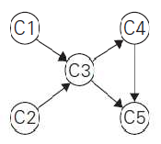
Motivation for topological sorting
Consider a set of five required courses {C1, C2, C3, C4, C5} a part-time student has to take in some degree program.
The courses can be taken in any order as long as the following course prerequisites are met:
  C1 and C2 have no prerequisites,
  C3 requires C1 and C2,
  C4 requires C3, and
  C5 requires C3 and C4.
The student can take only one course per term.
In which order should the student take the courses?

Slide 20
Topological Sort
For topological sorting to be possible, a digraph in question must be a DAG.
There are two efficient algorithms that both verify whether a digraph is a dag and, if it is, produce an ordering of vertices that solves the topological sorting problem.
  The first one is based on depth-first search
  the second is based on a direct application of the decrease-by-one technique.

Slide 21
Topological Sorting based on DFS
Method
Perform a DFS traversal and note the order in which vertices become dead-ends
Reversing this order yields a solution to the topological sorting problem,
provided, no back edge has been encountered during the traversal.
If a back edge has been encountered, the digraph is not a dag, and topological sorting of its vertices is impossible.

Slide 22
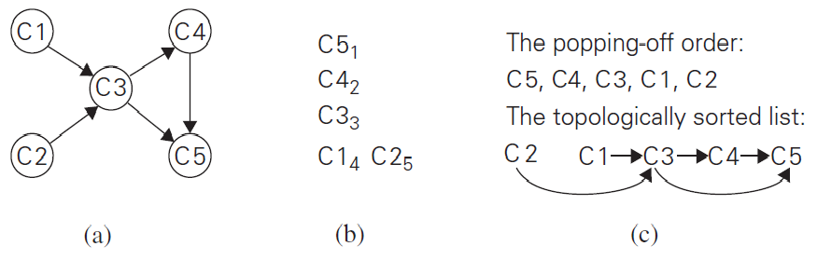

Slide 23
Topological Sorting using decrease-and-conquer technique:
Method: The algorithm is based on a direct implementation of the decrease-(by one)-and-conquer technique:
Repeatedly, identify in a remaining digraph a source, which is a vertex with no incoming edges, and delete it along with all the edges outgoing from it.
(If there are several sources, break the tie arbitrarily. If there are none, stop because the problem cannot be solved.)
The order in which the vertices are deleted yields a solution to the topological sorting problem.

Slide 24
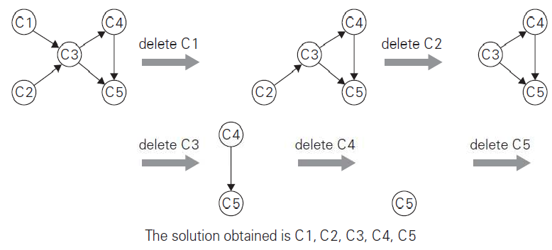
Illustration

Slide 25
Applications of Topological Sorting
Observation: Topological sorting problem may have several alternative solutions.
Instruction scheduling in program compilation
Cell evaluation ordering in spreadsheet formulas,
Resolving symbol dependencies in linkers.

Slide 26
Summary
Divide and Conquer
  Recurrence equation
  Binary search
  Finding the maximum and minimum
  Merge sort
  Quick sort
  Strassen’s matrix multiplication
Advantages and Disadvantages of D & C
Decrease and Conquer Approach
  Algorithm: Topological Sort

Slide 27
Web link
https://www.youtube.com/watch?v=gY0MwGLq9W8&list=PLyqSpQzTE6M9DKhN7z2fOpKTJWu-639_P

