Slide 1

K.S. SCHOOL OF ENGINEERING AND MANAGEMENT, BENGALURU-109
Dr. H.R.Radha
Assistant Professor
Department of Basic Science
KSSEM, Bengaluru-560109

Slide 2
MODULE 1: Chemistry of Electronic Materials (8hr)
1.Conductors and Insulators: Introduction, principle with examples.
2.Semiconductors: Introduction, production of electronic grade silicon Czochralski process (CZ) and Float Zone (FZ) methods.
3.Polymers:Introduction,Molecular, weight-Number average, Weight average and numerical problems.
4.Conducting polymers – synthesis and conducting mechanism of polyacetylene. Preparation, properties and commercial applications of graphene oxide.
5.PCB: Electroless plating – Introduction, Electroless plating of copper in the manufacture of double-sided PCB.
Self-learning: Technological importance of metal finishing and distinction between electroplating and electroless plating

Slide 3
MODULE 1: Chemistry of Electronic Materials (8hr) Blow UP
Conductors and Insulators: Definition of conductors, semiconductor and insulators based on band theory, principle with examples taking Cu, Si and Quartz or any suitable example(1 Hr).
Semiconductors: Introduction, production of electronic grade silicon from quartz (1 Hr)
i)Czochralski process (CZ) and ii) Float Zone (FZ) methods ( 1 Hr).
ii)Polymers: Importance and developments in the field of polymers (Definition of number and weight average molecular mass, Formulae their in) (1 Hr)
iii)Numerical problems on Number average and weight average molecular mass(1 Hr)
PCB: Electroless plating – Introduction, Electroless plating of copper in the manufacture of double- sided PCB. (1 Hr)
Conducting polymers – synthesis of polyacetylene, Conducting mechanism of polyacetylene.(1 Hr) Graphene Oxide: Preparation, properties and commercial applications. (1 Hr)

Slide 4
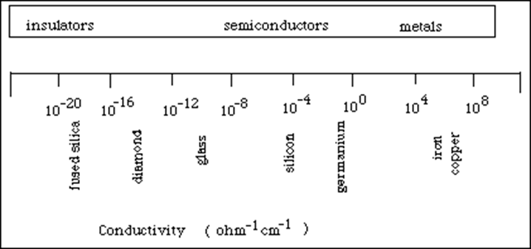
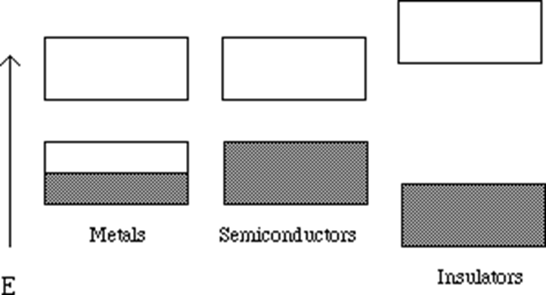
MODULE 1: Chemistry of Electronic Materials
Conductors and Insulators: Introduction to conductors and insulators, principle using band theory with examples.
http://matse1.matse.illinois.edu/sc/prin.html
Engg Chemistry by Jain and Jain or Shashi Chawla or S S Dara

Slide 5
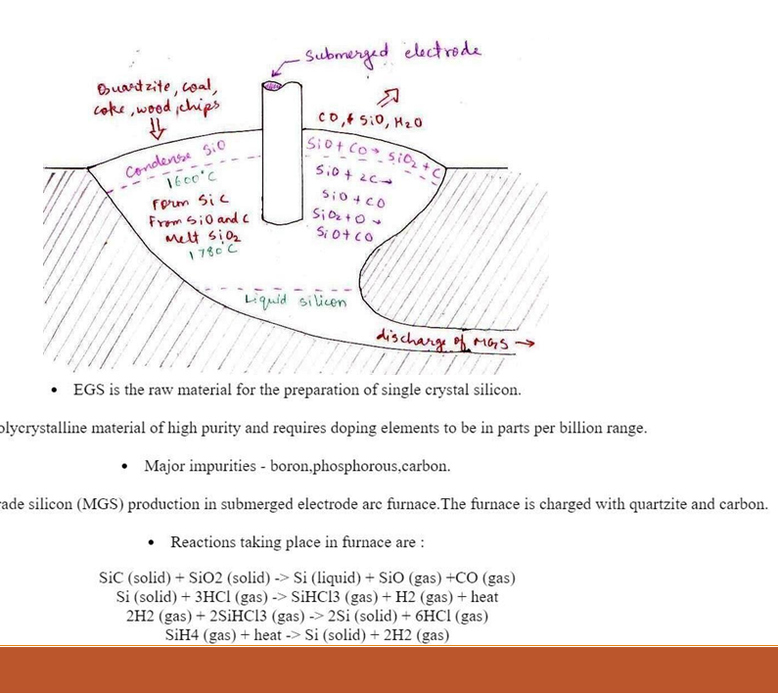
Production of electronic grade silicon

Slide 6
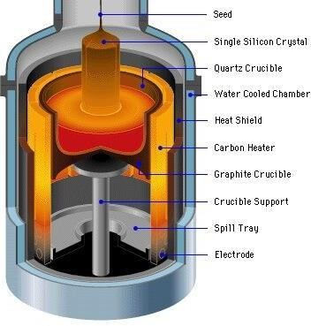
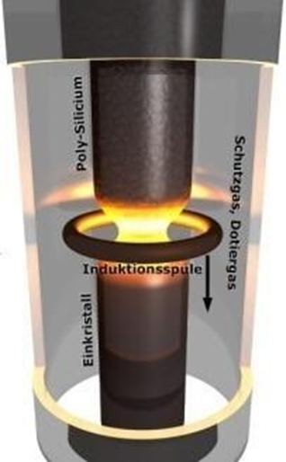
Semiconductors: Introduction, production of electronic grade silicon-Czochralski process (CZ) and Float Zone
(FZ) methods
Schematic setup of a Czochralski crystal puller
Schematic setup for the Float Zone (FZ) process

Slide 7
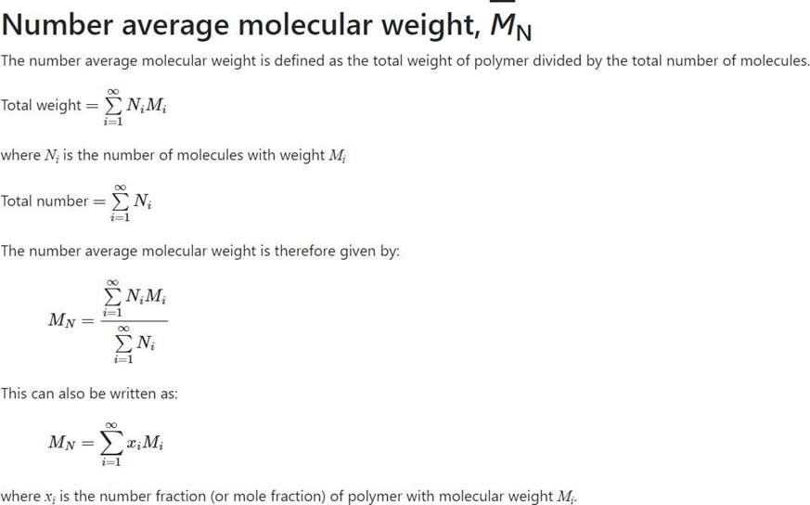
Polymers: Introduction to polymers and significance of molecular weight, Difference between Number average and Weight average.

Slide 8
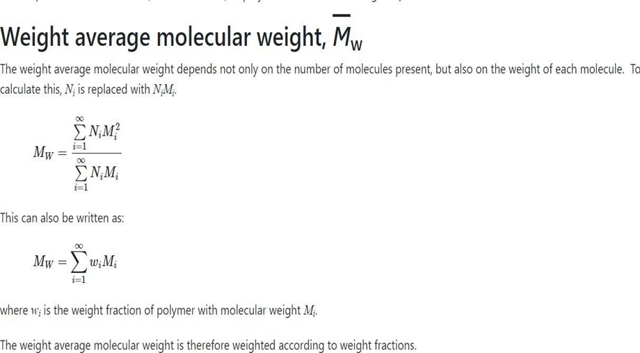

Slide 9
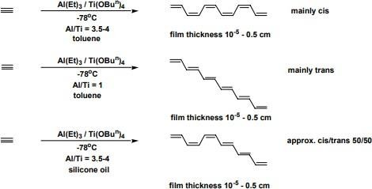
Conducting polymers synthesis and conducting mechanism of polyacetylene

Slide 10
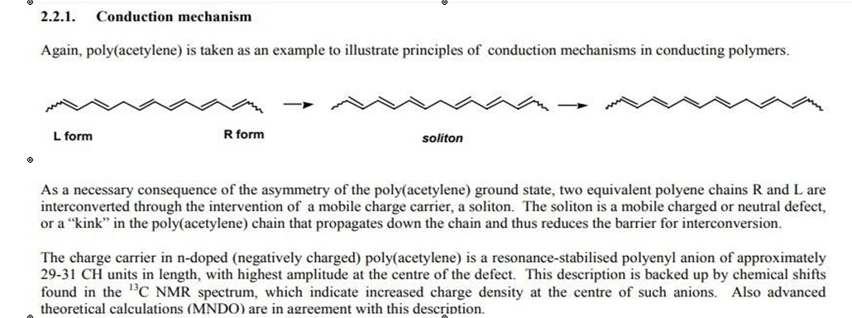
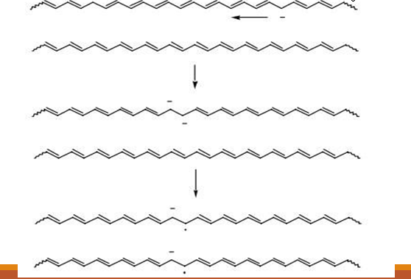

Slide 11
https://youtu.be/OYJZprAjmHg?feature=shared
https://youtu.be/u0h5IUouNk0?feature=shared
https://youtu.be/HE2zRQVhImw?feature=shared

