Slide 1

Cryptography
Department of Computer Science and Engineering
K S School of Engineering and Management, Bengaluru-560109
By,
Mrs. Nita Meshram
Assistant Professor,
Dept. of CSE, KSSEM, Bangalore

Slide 2
Text Books:
1. William Stallings: Cryptography and Network Security, Pearson 6th edition.

Slide 3
Reference Books:
1. V K Pachghare: Cryptography and Information Security, PHI 2nd Edition.

Slide 4
Credits, CIE and SEE Marks
Course Code : 18CS744
CIE Marks : 40
Hours/Week : 3:0:0
SEE Marks : 60
Total Contact Hrs : 50
Exam Hrs : 03
Total Credits : 3

Slide 5
Course Learning Objectives:
Define cryptography and its principles
Explain Cryptography algorithms
Illustrate Public and Private key cryptography
Explain Key management, distribution and certification Explain authentication protocols

Slide 6
Module-1 Syllabus
Module 1:
Classical Encryption Techniques Symmetric Cipher Model, Cryptography, Cryptanalysis and Brute-Force Attack, Substitution Techniques, Caesar Cipher, Mono alphabetic Cipher, Play fair Cipher, Hill Cipher, Polyalphabetic Cipher, One Time Pad. Block Ciphers and the data encryption standard: Traditional block Cipher structure, stream Ciphers and block Ciphers, Motivation for the feistel Cipher structure, the feistel Cipher, The data encryption standard, DES encryption, DES decryption, A DES example, results, the avalanche effect, the strength of DES, the use of 56-Bit Keys, the nature of the DES algorithm, timing attacks, Block cipher design principles, number of rounds, design of function F, key schedule algorithm
Text book 1: Chapter 1: 1.2 -1.7
RBT: L1, L2, L3
Contact Hours: 08

Slide 7
Some Definitions
Cryptography: is the method for protecting information and communication through codes , so that only the intended recipient can decipher the received message. OR The study if Creating Secret Messages(Encryption and Decryption)
Plain text: The original message or document before it is Encrypted.
Cipher : Message written in secret code.
Cipher text: The Encrypted Message.
Encryption: Hiding Message by using code or cipher.
Decryption: The process of recovering the original plaintext from the cipher text
Cryptanalysis: The study of breaking (deciphering) secret messages.

Slide 8
There are two types of Cryptography-
1. Single Key Encryption Or Symmetric Encryption
- Single Key Encryption Or Symmetric Encryption Algorithms
creates Fixed Length of bits called Block Cipher.
- Block Cipher Has the secrete Key that sender and Receiver can use
to Encrypt the data and Decrypt the data.
2. Public key or Asymmetric Encryption
- This uses the pair of keys , public key is associated with Sender to
encrypt the Message and other one to decryption.

Slide 9
Classical Encryption Techniques
Classical Encryption Techniques – here we should not send the data as plain text over the communication media as internet. It has two types,
Substitution Technique.
- Substitution Technique is Not Secured.
- we don’t use this Substitution Technique bcos of Advancement of Computer and Security.
- Substitution Technique are Easily Vulnerable to Attacks and Attackers
can Steal your Information.
    - Here Letters are Replaced with other Letters OR Symbols.
    - Ex. BAG can be Replaced with XMA.
    - Substitution Technique are Symmetric Encryption.
2. Transposition Technique
- In Transposition Technique we are Applying some sort of Permutation.
- Ex. NESO can be Replaced with ESON,SONE,ENOS

Slide 10
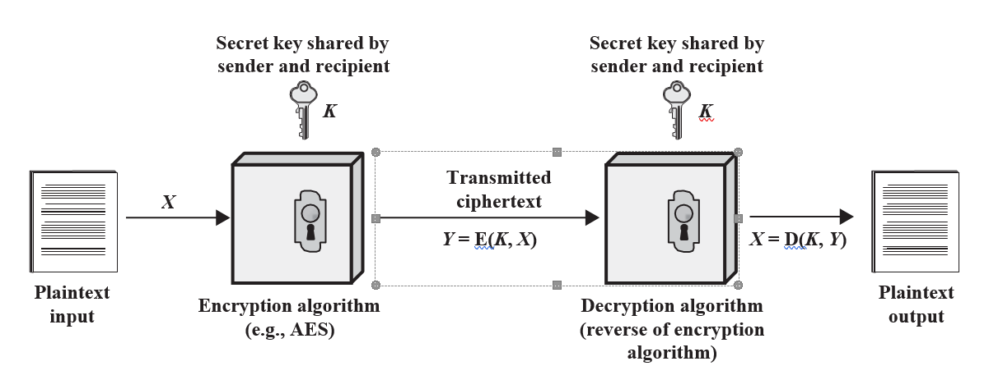
Symmetric Cipher Model
A symmetric encryption scheme has five ingredients

Slide 11
continue…
1. Plaintext: This is the original intelligible message or data that is fed into the algorithm as input.
2. Encryption algorithm: The encryption algorithm performs various substitutions and transformations on the plaintext.
3. Decryption algorithm: The Decryption algorithm performs various substitutions and transformations on the plaintext.
4. Secret key: The secret key is also input to the encryption algorithm. The key is a value independent of the plaintext and of the algorithm. The algorithm will produce a different output depending on the specific key being used at the time.
5. Ciphertext: This is the scrambled message produced as output. It depends on the plaintext and the secret key.

Slide 12
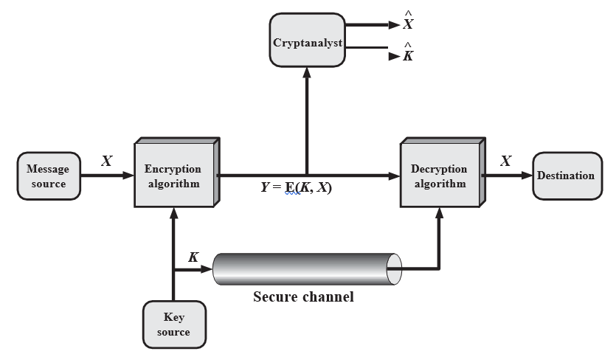
Figure: Model of Symmetric Cryptosystem

Slide 13
Cryptography
1. The type of operations used for transforming plaintext to ciphertext.
All encryption algorithms are based on two general principles: substitution, in which each element in the plaintext (bit, letter, group of bits or letters) is mapped into another element, and transposition, in which elements in the plaintext are rearranged.
The fundamental requirement is that no information be lost (i.e., that all operations are reversible). Most systems, referred to as product systems, involve multiple stages of substitutions and transpositions.
2. The number of keys used:- If both sender and receiver use the same key, the system is referred to as symmetric, single-key, secret-key, or conventional encryption. If the sender and receiver use different keys, the system is referred to as asymmetric, two-key, or public-key encryption.
3. The way in which the plaintext is processed. A block cipher processes the input one block of elements at a time, producing an output block for each input block. A stream cipher processes the input elements continuously, producing output one element at a time, as it goes along.

Slide 14
Cryptanalysis
Cryptanalysis: Cryptanalytic attacks rely on the nature of the algorithm plus perhaps some knowledge of the general characteristics of the plaintext OR even some sample plaintext–ciphertext pairs. This type of attack exploits the characteristics of the algorithm to attempt to deduce a specific plaintext or to deduce the key being used.

Slide 15
Brute-Force Attack
Brute-force attack: The attacker tries every possible key on a piece of cipher- text until an intelligible translation into plaintext is obtained. On average, half of all possible keys must be tried to achieve success.
That is, if there are X different keys, on average an attacker would discover the actual key after X>2 tries.
If the message is just plain text in English, then the result pops out easily, although the task of recognizing English would have to be automated.
If the text message has been compressed before encryption, then recognition is more difficult.
And if the message is some more general type of data, such as a numerical file, and this has been compressed, the problem becomes even more difficult to automate.
Thus, to supplement the brute-force approach, some degree of knowledge about the expected plaintext is needed, and some means of automatically distinguishing plaintext from garble is also needed.

Slide 16
Substitution Techniques
A substitution technique is one in which the letters of plaintext are replaced by other letters or by numbers or symbols.¹ If the plaintext is viewed as a sequence of bits, then substitution involves replacing plaintext bit patterns with ciphertext bit patterns.
Casear Cipher.
Monoalphabetic Ciphers - Defines a permutation of the elements in 𝞢.
There are 26! permutations; so, there are 26! possible monoalphabetic substitution ciphers.
3. Polyalphabetic Ciphers
The ciphertext corresponding to a particular character in the plaintext is not fixed.
4. The Vigenere Cipher: A polyalphabetic cipher that uses a multi-digit key.
5. The Hill Cipher: Another polyalphabetic cipher proposed by Lester Hill. In the Hill cipher an m x m matrix of integers between 0 and 25. Each character in the cipher text is a function of all the characters in that block.
6. One time Pad: Most secured cipher. Both parties that wish to communicate agree before and to an arbitrarily long, random, and non-repeating sequence of characters. Performs encryption in much the same way as the Vigenere cipher.

Slide 17
1. Caesar Cipher
Old Encryption Technique.(Not in Use Nowadays)
Substitution cipher was by Julius Caesar.
The Caesar cipher involves replacing each letter of the alphabet with the letter standing three places further down the alphabet.
Step 1:- For each plain text letter ‘P’ , substitute the cipher text letter ‘C’
Step 2:- C= E(P,K) MOD 26 =(P+K) MOD 26
    P= D(C,K) MOD 26 =(P-K) MOD 26
For example,
Step1:-
plain: a b c d e f g h i j k l m n o p q r s t u v w x y z
cipher: d ef g h i j k l m n op q r s t u v w x y z a b c

Slide 18
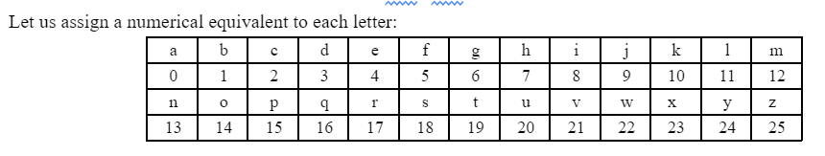
Contd….

Slide 19
Monoalphabetic Cipher
Only with 25 possible keys , Ceaser cipher is not secure.
In this technique we are using permutation of 26 alphabetic characters.
Permutation:- S={Finite set of sequences ,
An ordered sequence ,
Each element appearing once }
The permutations of n number is n!
n=n!

Slide 20
Playfair Cipher
The best-known multiple-letter encryption cipher.
Here we will make use of diagram that is 5*5 matrix of letters.
Playfair cipher also known as Playfair square or Wheatstone Playfair cipher.
Rules for encryption:
Step 1:- Create a Diagram for plaintext.
Step 2:- Firstly, fill the matrix with given key (Do not write repeated letters) and then fill the remaining alphabets in the matrix. I and J should be considered in one cell.
Step 3:- Repeating letters, fill with filler characters.
For example:- JAZZ (Plaintext)
JA ZZ (ZZ are repeating letters) So separate them and fill the filler character. JA ZX ZX
Here X is the filler Character (Any letter can be considered as a filler character).

Slide 21
Step 4:- If both the letters are in same column, just move one cell down to get cipher text | |. (Wrap around if needed)
Step 5:- If both letters are in same row, move one step forward
| | to get cipher text. (Wrap around if needed)
Step 6:- If both the letters are in different row and different column, form the rectangle / square and replace with end letter / first letter.

Slide 22
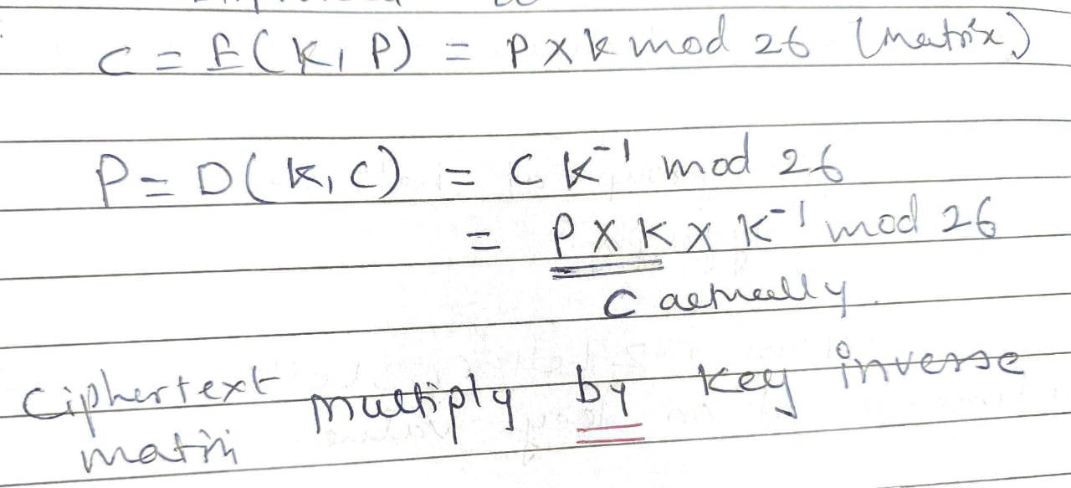
Hill Cipher
It is multiple-letter encryption cipher.
It improves the security compared to playfair cipher.
It encrypts group of letters, diagraph, trigraph or polygraph.
Hill Algorithm has two portions:-
Encryption and Decryption.

Slide 23
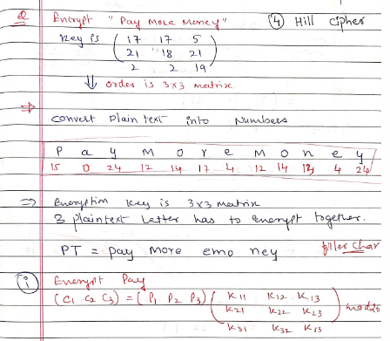

Slide 24
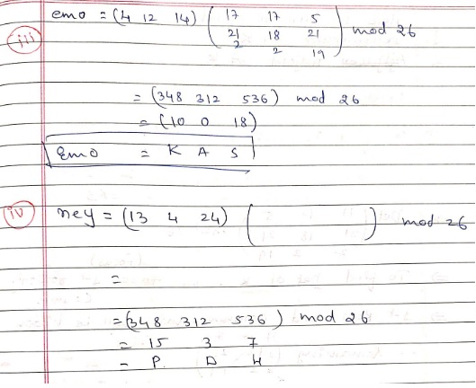

Slide 25
Polyalphabetic Ciphers
Another way to improve on the simple monoalphabetic technique.
Vigenère Cipher The best known, and one of the simplest, polyalphabetic ciphers is the Vigenère cipher.
In this scheme, the set of related monoalphabetic substitution rules consists of the 26 Caesar ciphers with shifts of 0 through 25.
Each cipher is denoted by a key letter, which is the ciphertext letter that substitutes for the plaintext letter a. Thus, a Caesar cipher with a shift of 3 is denoted by the key value 3.

Slide 26


A general equation of the encryption process is
Decryption is a generalization of Equation
To encrypt a message, a key is needed that is as long as the message.
Usually, the key is a repeating keyword.
For example, if the keyword is deceptive, the message “we are discovered save yourself” is encrypted as

Slide 27
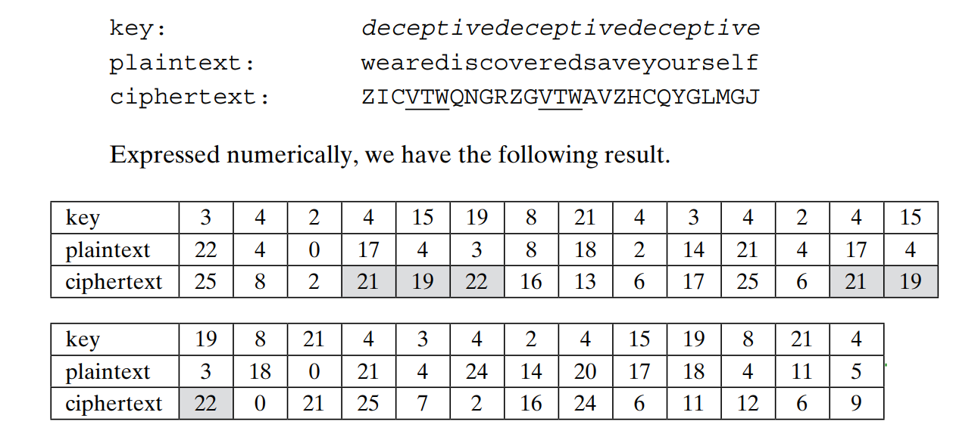

Slide 28
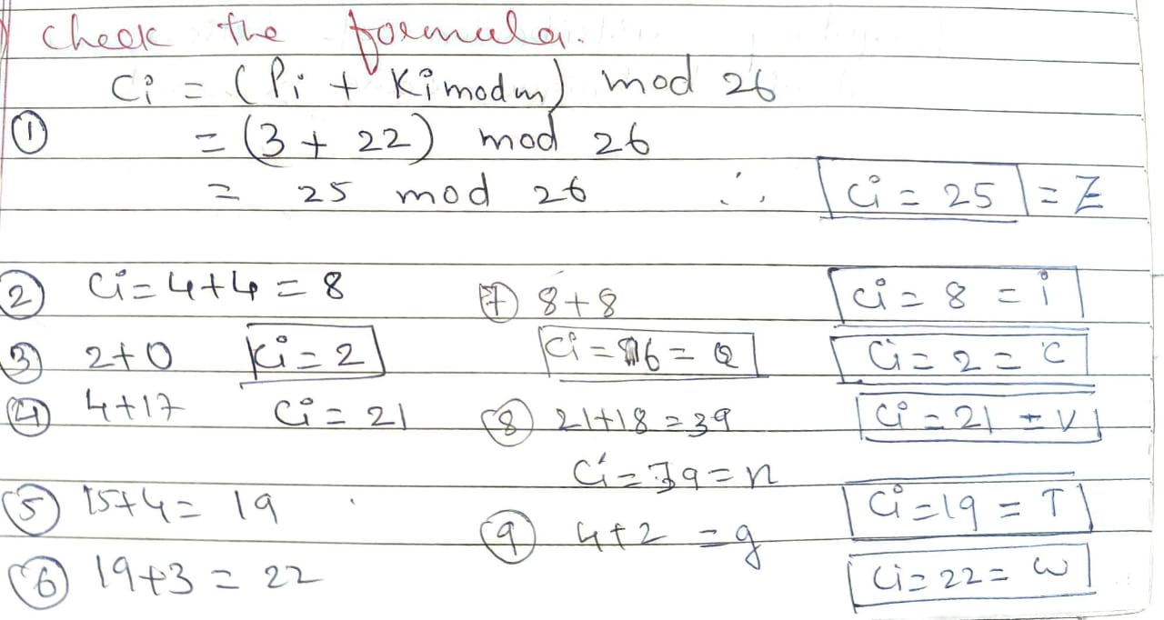

Slide 29
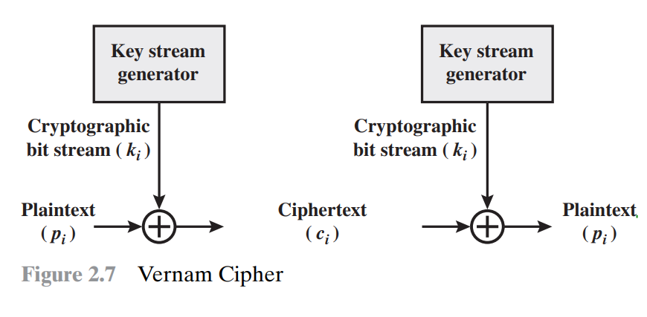
Vernam Cipher
Vernam Cipher is a method of encrypting alphabetic text.
It is one of the Substitution techniques for converting plain text into cipher text.
In this mechanism we assign a number to each character of the Plain-Text, like (a = 0, b = 1, c = 2, … z = 25).

Slide 30
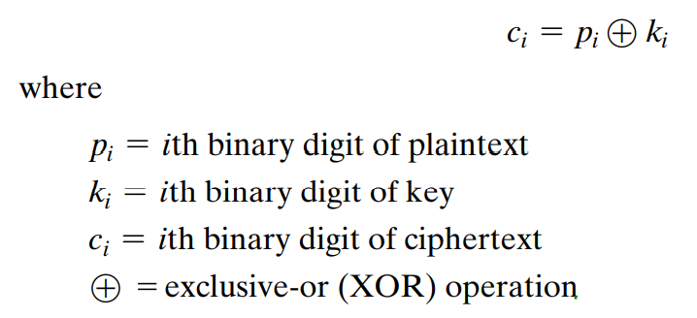

Slide 31
Block Ciphers and the Data Encryption Standard
Traditional Block Cipher Structure:-
1. Stream Cipher and Block Ciphers
2. Motivation for the Feistel Cipher Structure
3. The Feistel Cipher
Stream Cipher and Block Ciphers
A stream cipher is one that encrypts a digital data stream one bit or one byte at a time.
The bit-stream generator must be implemented as an algorithmic procedure.
The bit-stream generator is a key-controlled algorithm and must produce a bit stream

Slide 32
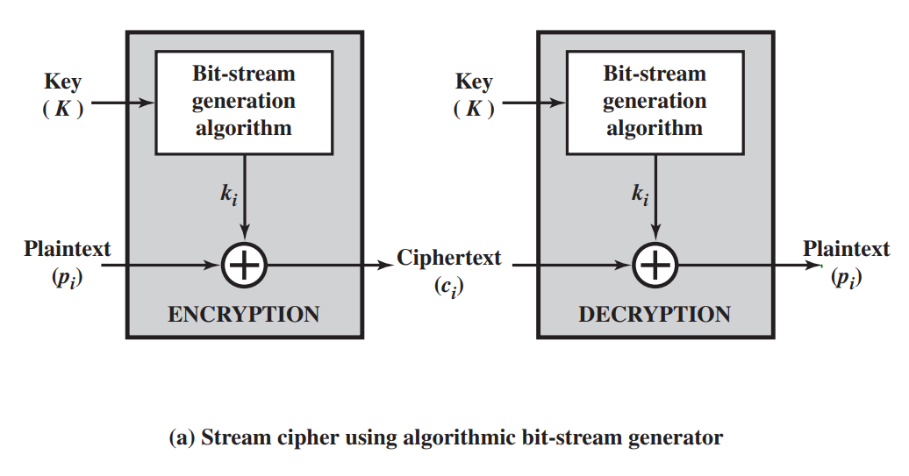

Slide 33
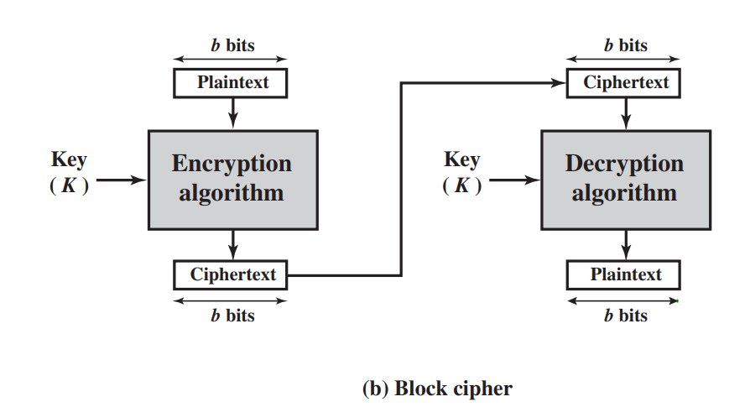
A Block cipher is one in which a block of plaintext is treated as a whole and used to produce a ciphertext block of equal length.
Typically, a block size of 64 or 128 bits is used. As with a stream cipher, the two users share a symmetric encryption key.

Slide 34
Motivation for the Feistel Cipher Structure
Motivation for the Feistel Cipher Structure A block cipher operates on a plaintext block of n bits to produce a ciphertext block of n bits.
There are 2n possible different plaintext blocks and, for the encryption to be reversible (i.e., for decryption to be possible), each must produce a unique ciphertext block or nonsingular.
The following examples illustrate nonsingular and singular transformations for n = 2.

Slide 35
Fiestel Cipher
The execution of two or more simple ciphers in sequence in such a way that the final result or product is cryptographically stronger than any of the component ciphers.
Feistel proposed the use of a cipher that alternates substitutions and permutations, where these terms are defined as follows:
• Substitution: Each plaintext element or group of elements is uniquely replaced by a corresponding ciphertext element or group of elements.
• Permutation: A sequence of plaintext elements is replaced by a permutation of that sequence. That is, no elements are added or deleted or replaced in the sequence, rather the order in which the elements appear in the sequence is changed

Slide 36
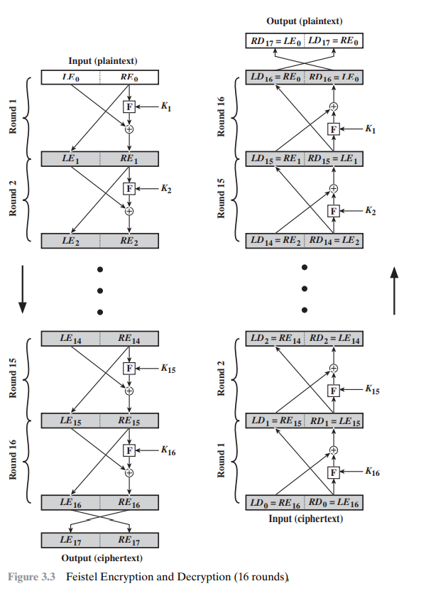

Slide 37
Feistel proposed a scheme to produce a block cipher using permutation and substitution alternatively.
Block size: Larger block sizes mean greater security (all other things being equal) but reduced encryption/decryption speed for a given algorithm. The greater security is achieved by greater diffusion. Traditionally, a block size of 64 bits has been considered a reasonable tradeoff and was nearly universal in block cipher design. However, the new AES uses a 128-bit block size.
• Key size: Larger key size means greater security but may decrease encryption/ decryption speed. The greater security is achieved by greater resistance to brute-force attacks and greater confusion. Key sizes of 64 bits or less are now widely considered to be inadequate, and 128 bits has become a common size.

Slide 38
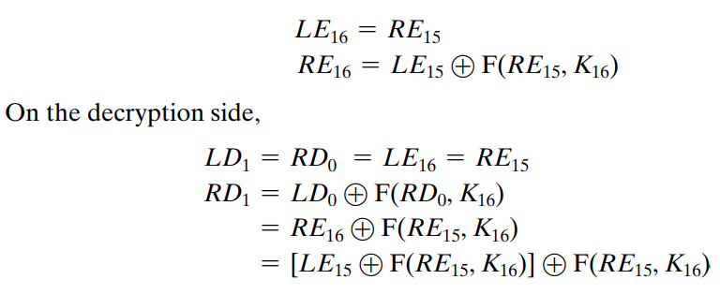
Cont.…..
First, consider the encryption process.

Slide 39
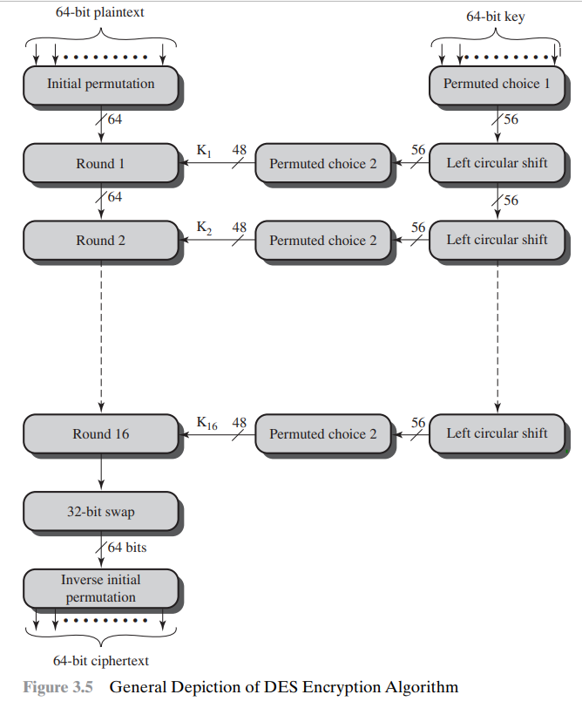
The Data Encryption Standard

Slide 40
DES Encryption:-
It is a block cipher Data encryption Standard.
A 64-bit plain text and a 64-bit key is given as a input to generate the 64-bit cipher text.
It follow symmetric cipher because it used same key for encryption and decryption. It has total 16 rounds of feistel structure.
Steps:- 1. Initial Permutation (rearrangement of letters).
Step 2. After rearrangement of 64-bits it will pass through 16 feistel rounds along with the key .

Slide 41
The 64-bit key will be initially permuted and reduced to 56-bit key where left-circular shift takes place and on that again permutation is done and the key is reduced to 48-bit.
Now the 48-bit key will be the input for the fiestel rounds.
Step 3:- A 32-bit swapping will take place on the output generated after the 16 rounds of feistel.
Step 4:- Inverse Initial Permutation will take place to generate the cipher text.
DES Decryption:-
As with any Feistel cipher, decryption uses the same algorithm as encryption, except that the application of the subkeys is reversed.
Additionally, the initial and final permutations are reversed

Slide 42
The Avalanche Effect
A desirable property of any encryption algorithm is that a small change in either the plaintext or the key should produce a significant change in the ciphertext.
In particular, a change in one bit of the plaintext or one bit of the key should produce a change in many bits of the ciphertext.
This is referred to as the avalanche effect.
It is also called as Completeness effect.

Slide 43
The Strength of DES
Use of 56-bit key size
The nature of the algorithm
Timing Attacks
1. Use of 56-bit key size :-
With a key length of 56 bits, there are 2⁵⁶ possible keys, which is approximately 7.2 * 10¹⁶ keys.
Thus, on the face of it, a brute-force attack appears impractical.

Slide 44
Block Cipher Design Principles
Number of Rounds:-
The cryptographic strength of a Feistel cipher derives from three aspects of the design: the number of rounds, the function F, and the key schedule algorithm.
The greater the number of rounds, the more difficult it is to perform cryptanalysis.
In general, the criterion should be that the number of rounds is chosen so that known cryptanalytic efforts require greater effort than a simple brute-force key search attack.
In the absence of a cryptanalytic breakthrough, the strength of any algorithm depends on key length.

Slide 45
Useful links
https://www.youtube.com/watch?v=6_Cxj5WKpIw
https://www.youtube.com/watch?v=-xYceXP8uoY&t=636s
https://www.youtube.com/watch?v=iTVyKbDCJrA&list=PLgMDNELGJ1CbdGLyn7OrVAP-IKg-0q2U2

Slide 46
END
OF
MODULE 1

