Slide 1

Module 1
Basic Structure of Computers
Subject Name: Computer Organization(18CS51)
Name of the Faculty: Mrs. R S Geethanjali
Department of Computer Science and Engineering
K S School of Engineering and Management, Bengaluru-560109

Slide 2
Computer Organization
Subject code: 18CS34
Textbook:
1. Carl Hamacher, Zvonko Vranesic, Safwat Zaky, Computer Organization, 5th Edition 2002.
‹#›

Slide 3
Outline
Basic Operational Concepts
Bus Structures
Basic Performance Equation
Performance Measurement
Machine Instructions and Programs
Memory Operations
Memory Operations
Addressing Modes
Encoding of Machine Instructions
‹#›
Notes:
‹#›
*
MITE

Slide 4
Learning Objectives
Understand the basics of computer organization: structure and operation of computers and their peripherals
Understand the concepts of programs as sequences or machine instructions.
To analyse various addressing modes and machine instructions
To study basic IO operations and Stack operations
‹#›

Slide 5
Computer organization vs Computer Architecture
Computer architecture refers to those attributes of a system visible to a programmer
Computer organization refers to the operational units and their interconnections that realize the architectural specifications.
‹#›

Slide 6
BASIC CONCEPTS
Computer Architecture (CA) covers 3 aspects of computer-design namely:
1) Computer Hardware
2) Instruction set Architecture
3) Computer Organization.
CISC(Complex Instruction Set Computer)
RISC(Reduced Instruction Set Computer)
‹#›

Slide 7
Functional Units

Slide 8
Functional Units
Arithmetic
Input
and
logic
Memory
Output
Control
I/O
Processor
Figure 1.1. Basic functional units of a computer.
‹#›

Slide 9
Information Handled by a Computer
Instructions/machine instructions
Govern the transfer of information within a computer as well as between the computer and its I/O devices
Specify the arithmetic and logic operations to be performed
Program
Data
Used as operands by the instructions
Source program
Encoded in binary code – 0 and 1
‹#›

Slide 10
Memory Unit
Store programs and data
Two classes of storage
Primary storage
Fast
Programs must be stored in memory while they are being executed
Large number of semiconductor storage cells
Processed in words
Address
RAM and memory access time
Memory hierarchy – cache, main memory
Secondary storage – larger and cheaper
‹#›

Slide 11
Arithmetic and Logic Unit (ALU)
Most computer operations are executed in ALU of the processor.
Load the operands into memory – bring them to the processor – perform operation in ALU – store the result back to memory or retain in the processor.
Registers
Fast control of ALU
‹#›

Slide 12
Control Unit
All computer operations are controlled by the control unit.
The timing signals that govern the I/O transfers are also generated by the control unit.
Control unit is usually distributed throughout the machine instead of standing alone.
Operations of a computer:
Accept information in the form of programs and data through an input unit and store it in the memory
Fetch the information stored in the memory, under program control, into an ALU, where the information is processed
Output the processed information through an output unit
Control all activities inside the machine through a control unit
‹#›

Slide 13
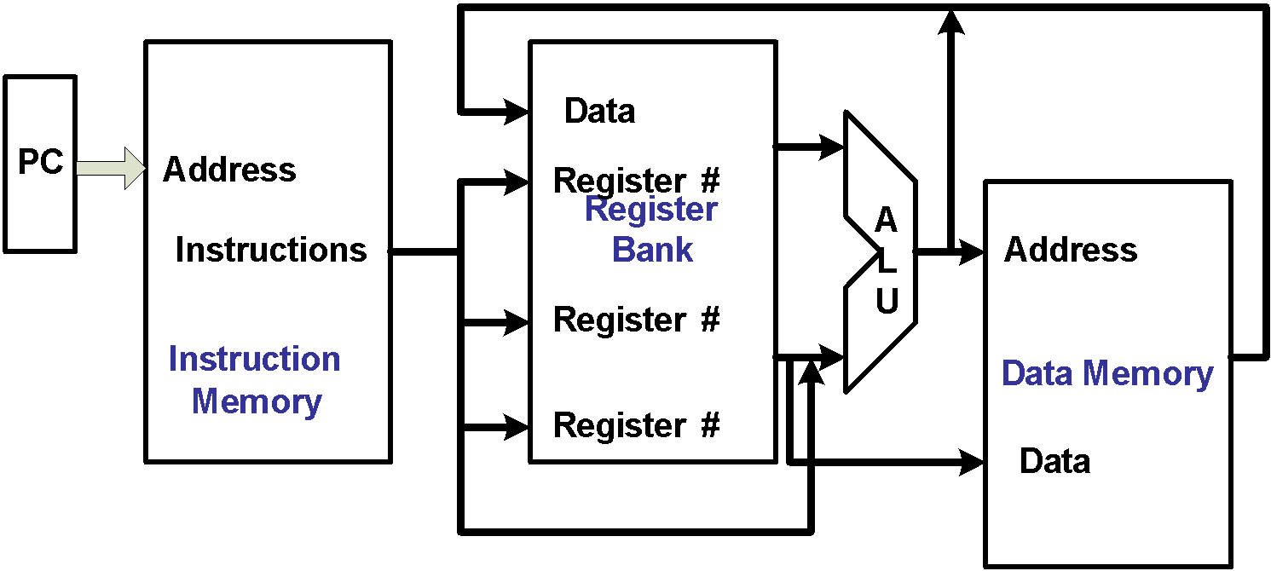
The processor : Data Path and Control
Two types of functional units:
  elements that operate on data values (combinational)
  elements that contain state (state elements)
‹#›

Slide 14
Basic Operational Concepts

Slide 15
Review
Activity in a computer is governed by instructions.
To perform a task, an appropriate program consisting of a list of instructions is stored in the memory.
Individual instructions are brought from the memory into the processor, which executes the specified operations.
Data to be used as operands are also stored in the memory.
‹#›

Slide 16
A Typical Instruction
Add LOCA, R0
Add the operand at memory location LOCA to the operand in a register R0 in the processor.
Place the sum into register R0.
The original contents of LOCA are preserved.
The original contents of R0 is overwritten.
Instruction is fetched from the memory into the processor – the operand at LOCA is fetched and added to the contents of R0 – the resulting sum is stored in register R0.
‹#›

Slide 17
Separate Memory Access and ALU Operation
Load LOCA, R1
Add R1, R0
Whose contents will be overwritten?
‹#›

Slide 18
Connection Between the Processor and the Memory
‹#›

Slide 19
Registers
Instruction register (IR)
Program counter (PC)
General-purpose register (R₀ – R_{n-1})
Memory address register (MAR)
Memory data register (MDR)
‹#›

Slide 20
Typical Operating Steps
Programs reside in the memory through input devices
PC is set to point to the first instruction
The contents of PC are transferred to MAR
A Read signal is sent to the memory
The first instruction is read out and loaded into MDR
The contents of MDR are transferred to IR
Decode and execute the instruction
‹#›

Slide 21
Typical Operating Steps (Cont’)
Get operands for ALU
  General-purpose register
  Memory (address to MAR – Read – MDR to ALU)
Perform operation in ALU
Store the result back
  To general-purpose register
  To memory (address to MAR, result to MDR – Write)
During the execution, PC is incremented to the next instruction
‹#›

Slide 22
Interrupt
Normal execution of programs may be preempted if some device requires urgent servicing.
The normal execution of the current program must be interrupted – the device raises an interrupt signal.
Interrupt-service routine
Current system information backup and restore (PC, general-purpose registers, control information, specific information)
‹#›

Slide 23
Bus Structures
There are many ways to connect different parts inside a computer together.
A group of lines that serves as a connecting path for several devices is called a bus.
Address/data/control
‹#›

Slide 24
Bus Structure
Single-bus
‹#›

Slide 25
Speed Issue
Different devices have different transfer/operate speed.
If the speed of bus is bounded by the slowest device connected to it, the efficiency will be very low.
How to solve this?
A common approach – use buffers.
‹#›

Slide 26
Performance

Slide 27
Performance
The most important measure of a computer is how quickly it can execute programs.
Three factors affect performance:
Hardware design
Instruction set
Compiler
‹#›

Slide 28
Performance
Processor time to execute a program depends on the hardware involved in the execution of individual machine instructions.
Main
Cache
memory
memory
Processor
Bus
Figure 1.5.
The processor cache.
‹#›

Slide 29
Performance
The processor and a relatively small cache memory can be fabricated on a single integrated circuit chip.
Speed
Cost
Memory management
‹#›

Slide 30
Processor Clock
Clock, clock cycle, and clock rate
The execution of each instruction is divided into several steps, each of which completes in one clock cycle.
Hertz – cycles per second
‹#›

Slide 31
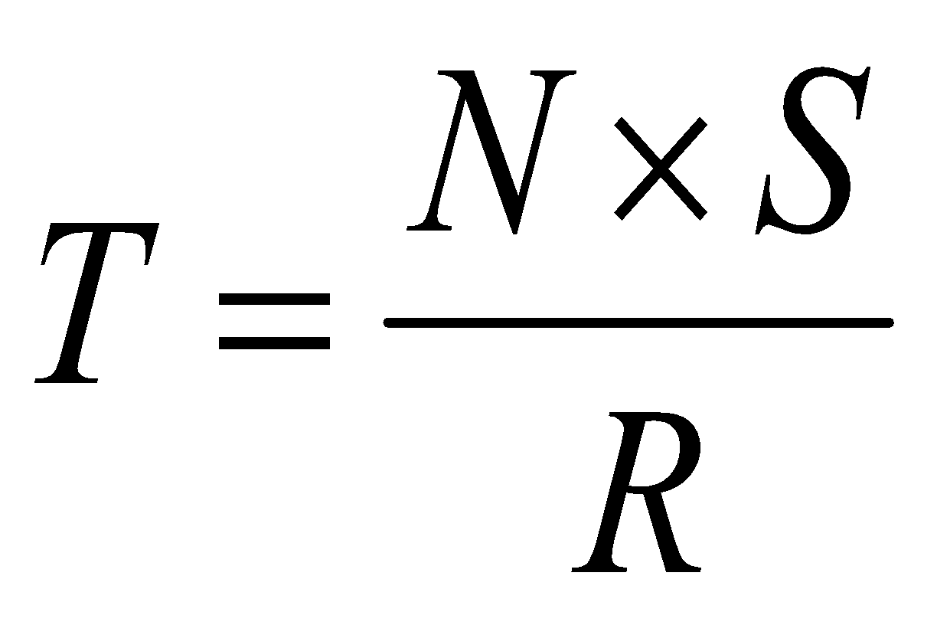
Basic Performance Equation
T – processor time required to execute a program that has been prepared in high-level language
N – number of actual machine language instructions needed to complete the execution (note: loop)
S – average number of basic steps needed to execute one machine instruction. Each step completes in one clock cycle
R – clock rate
Note: these are not independent to each other
How to improve T?
‹#›

Slide 32
Pipeline
Instructions are not necessarily executed one after another.
The value of S doesn’t have to be the number of clock cycles to execute one instruction.
Pipelining – overlapping the execution of successive instructions.
‹#›

Slide 33
Clock Rate
Increase clock rate
Improve the integrated-circuit (IC) technology to make the circuits faster
Reduce the amount of processing done in one basic step (however, this may increase the number of basic steps needed)
Increases in R that are entirely caused by improvements in IC technology affect all aspects of the processor’s operation equally except the time to access the main memory.
‹#›

Slide 34
Compiler
A compiler translates a high-level language program into a sequence of machine instructions.
To reduce N, we need a suitable machine instruction set and a compiler that makes good use of it.
Goal – reduce N×S
A compiler may not be designed for a specific processor; however, a high-quality compiler is usually designed for, and with, a specific processor.
‹#›

Slide 35
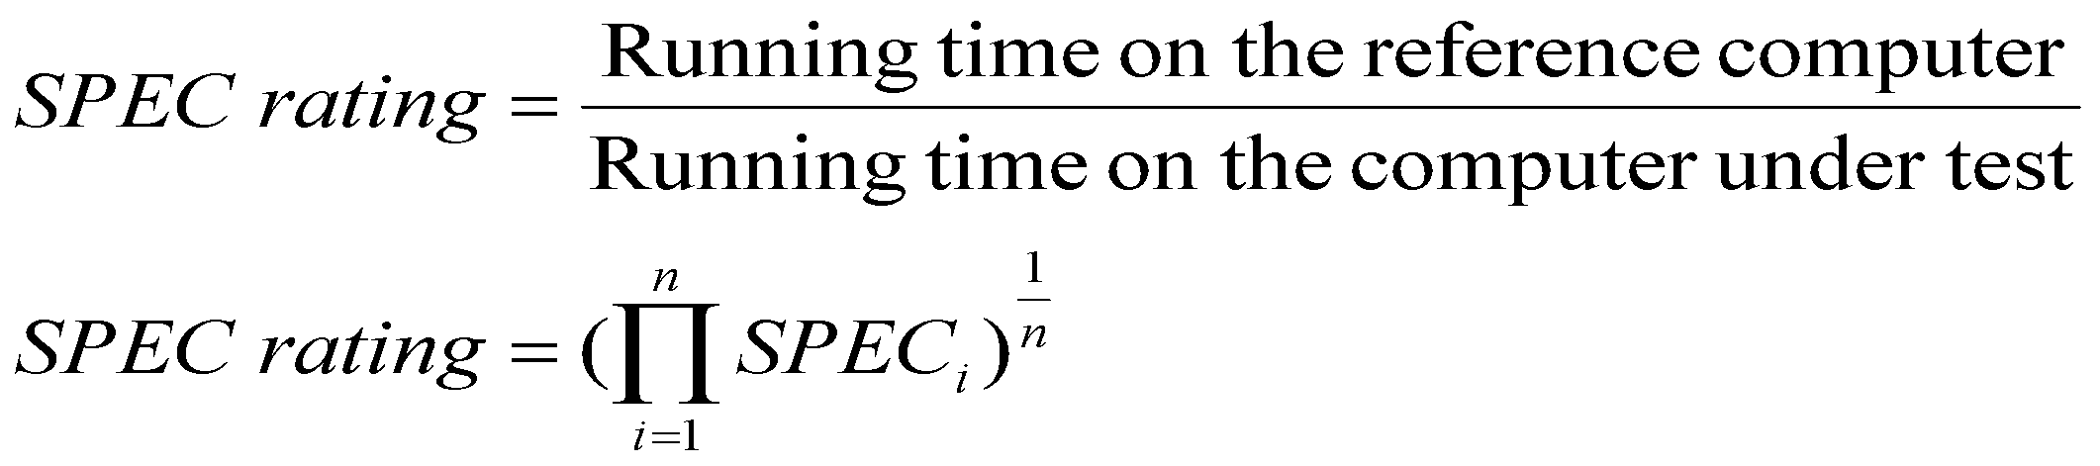
Performance Measurement
T is difficult to compute.
Measure computer performance using benchmark programs.
System Performance Evaluation Corporation (SPEC) selects and publishes representative application programs for different application domains, together with test results for many commercially available computers.
Compile and run (no simulation)
Reference computer
‹#›

Slide 36
Machine Instructions and Programs
‹#›
Notes:
‹#›
‹#›
*
MITE

Slide 37
Objectives
Machine instructions and program execution, including branching and subroutine call and return operations.
Addressing methods for accessing register and memory operands.
Assembly language for representing machine instructions, data, and programs.
Program-controlled Input/Output operations.
‹#›
Notes:
‹#›
‹#›
*
MITE

Slide 38
Memory Locations, Addresses, and Operations
‹#›
Notes:
‹#›
‹#›
*
MITE

Slide 39
Memory Location, Addresses, and Operation
n
bits
Memory consists of many millions of storage cells, each of which can store 1 bit.
Data is usually accessed in n-bit groups. n is called word length.
first word
second word
•
•
•
i
th word
•
•
•
last word
‹#›
Figure 2.5. Memory words.
Notes:
‹#›
‹#›
*
MITE

Slide 40
Memory Location, Addresses, and Operation
32-bit word length example
32 bits
•
•
•
b
31
b
30
b
1
b
0
Sign bit:
b
31
=
0
for positive numbers
b
31
=
1
for negative numbers
(a) A signed integer
8 bits
8 bits
8 bits
8 bits
ASCII
ASCII
ASCII
ASCII
character
character
character
character
‹#›
(b) Four characters
Notes:
‹#›
‹#›
*
MITE

Slide 41
Memory Location, Addresses, and Operation
To retrieve information from memory, either for one word or one byte (8-bit), addresses for each location are needed.
A k-bit address memory has 2^{k} memory locations, namely 0 – 2^{k}-1, called memory space.
24-bit memory: 2²⁴ = 16,777,216 = 16M (1M=2²⁰)
32-bit memory: 2³² = 4G (1G=2³⁰)
1K(kilo)=2¹⁰
1T(tera)=2⁴⁰
‹#›
Notes:
‹#›
‹#›
*
MITE

Slide 42
Memory Location, Addresses, and Operation
It is impractical to assign distinct addresses to individual bit locations in the memory.
The most practical assignment is to have successive addresses refer to successive byte locations in the memory – byte-addressable memory.
Byte locations have addresses 0, 1, 2, … If word length is 32 bits, they successive words are located at addresses 0, 4, 8,…
‹#›
Notes:
‹#›
‹#›
*
MITE

Slide 43
Big-Endian and Little-Endian Assignments
Big-Endian: lower byte addresses are used for the most significant bytes of the word
Little-Endian: opposite ordering. lower byte addresses are used for the less significant bytes of the word
W
ord
address
Byte address
Byte address
0
0
1
2
3
0
3
2
1
0
4
4
5
6
7
4
7
6
5
4
•
•
•
•
•
•
2
k
-
4
2
k
-
4
2
k
-
3
2
k
-
2
2
k
-
1
2
k
-
4
2
k
-
1
2
k
-
2
2
k
-
3
2
k
-
4
(a) Big-endian assignment
(b) Little-endian assignment
‹#›
Figure 2.7. Byte and word addressing.
Notes:
‹#›
‹#›
*
MITE

Slide 44
Memory Location, Addresses, and Operation
Address ordering of bytes
Word alignment
  Words are said to be aligned in memory if they begin at a byte addr. that is a multiple of the num of bytes in a word.
    16-bit word: word addresses: 0, 2, 4,….
    32-bit word: word addresses: 0, 4, 8,….
    64-bit word: word addresses: 0, 8,16,….
Access numbers, characters, and character strings
‹#›
Notes:
‹#›
‹#›
*
MITE

Slide 45
Memory Operation
Load (or Read or Fetch)
Copy the content. The memory content doesn’t change.
Address – Load
Registers can be used
Store (or Write)
Overwrite the content in memory
Address and Data – Store
Registers can be used
‹#›
Notes:
‹#›
‹#›
*
MITE

Slide 46
Instruction and Instruction Sequencing
‹#›
Notes:
‹#›
‹#›
*
MITE

Slide 47
“Must-Perform” Operations
Data transfers between the memory and the processor registers(MOV,PUSH,POP,XCHG)
Arithmetic and logic operations on data(ADD,SUB,MUL,DIV,AND,OR,NOT)
Program sequencing and control(LOOP,INT)
I/O transfers(IN,OUT)
‹#›
Notes:
‹#›
‹#›
*
MITE

Slide 48
Register Transfer Notation
Identify a location by a symbolic name standing for its hardware binary address (LOC, R0,…)
Contents of a location are denoted by placing square brackets around the name of the location (R1←[LOC], R3 ←[R1]+[R2])
Register Transfer Notation (RTN)
‹#›
Notes:
‹#›
‹#›
*
MITE

Slide 49
Assembly Language Notation
Represent machine instructions and programs.
Move LOC, R1 = R1←[LOC]
Add R1, R2, R3 = R3 ←[R1]+[R2]
‹#›
Notes:
‹#›
‹#›
*
MITE

Slide 50
CPU Organization
Single Accumulator
  Result usually goes to the Accumulator
  Accumulator has to be saved to memory quite often
General Register
  Registers hold operands thus reduce memory traffic
  Register bookkeeping
Stack
  Operands and result are always in the stack
‹#›

Slide 51
Instruction Formats
Three-Address Instructions
  ADD R1, R2, R3 R1 ← R2 + R3
Two-Address Instructions
  ADD R1, R2 R1 ← R1 + R2
One-Address Instructions
  ADD M AC ← AC + M[AR]
Zero-Address Instructions
  ADD TOS ← TOS + (TOS – 1)
RISC Instructions
  Lots of registers. Memory is restricted to Load & Store
Instruction
Opcode
Operand(s) or Address(es)
‹#›

Slide 52
Instruction Formats
Example: Evaluate (A+B) * (C+D)
Three-Address
  ADD R1, A, B ; R1 ← M[A] + M[B]
  ADD R2, C, D ; R2 ← M[C] + M[D]
  MUL X, R1, R2 ; M[X] ← R1 * R2
‹#›

Slide 53
Instruction Formats
Example: Evaluate (A+B) * (C+D)
Two-Address
  MOV R1, A ; R1 ← M[A]
  ADD R1, B ; R1 ← R1 + M[B]
  MOV R2, C ; R2 ← M[C]
  ADD R2, D ; R2 ← R2 + M[D]
  MUL R1, R2 ; R1 ← R1 * R2
  MOV X, R1 ; M[X] ← R1
‹#›

Slide 54
Using Registers
Registers are faster
Shorter instructions
  The number of registers is smaller (e.g. 32 registers need 5 bits)
Potential speedup
Minimize the frequency with which data is moved back and forth between the memory and processor registers.
‹#›
Notes:
‹#›
‹#›
*
MITE

Slide 55
Instruction Execution and Straight-Line Sequencing
Address
Contents
Assumptions:
- One memory operand
per instruction
- 32-bit word length
- Memory is byte
addressable
- Full memory address
can be directly specified
in a single-word instruction
Begin execution here
i
Move
A,R0
3-instruction
i
+ 4
Add
B,R0
program
segment
i
+ 8
Move
R0,C
A
B
Data for
the program
Two-phase procedure
Instruction fetch
Instruction execute
C
Page 43
‹#›
Figure 2.8. A program for C ← [Α] + [Β].
Notes:
‹#›
‹#›
*
MITE

Slide 56
Branching
i
Move
NUM1,R0
i
+
4
Add
NUM2,R0
i
+
8
Add
NUM3,R0
•
•
•
i
+
4
n
-
4
Add
NUM
n
,R0
i
+
4
n
Move
R0,SUM
•
•
•
SUM
NUM1
NUM2
•
•
•
NUM
n
‹#›
Figure 2.9. A straight-line program for adding n numbers.
Notes:
‹#›
‹#›
*
MITE

Slide 57
Branching
Move
N,R1
Clear
R0
LOOP
Determine address of
"Next" number and add
Program
"Next" number to R0
loop
Decrement
R1
Branch target
Branch>0
LOOP
Move
R0,SUM
Conditional branch
•
•
•
SUM
N
n
NUM1
Figure 2.10. Using a loop to add n numbers.
NUM2
•
•
•
NUM
n
‹#›
Notes:
‹#›
‹#›
*
MITE

Slide 58
Condition Codes
Condition code flags
Condition code register / status register
N (negative)
Z (zero)
V (overflow)
C (carry)
Different instructions affect different flags
‹#›
Notes:
‹#›
‹#›
*
MITE

Slide 59
Addressing Modes
‹#›
Notes:
‹#›
‹#›
*
MITE

Slide 60
Generating Memory Addresses
How to specify the address of branch target?
Can we give the memory operand address directly in a single Add instruction in the loop?
Use a register to hold the address of NUM1; then increment by 4 on each pass through the loop.
‹#›
Notes:
‹#›
‹#›
*
MITE

Slide 61
Addressing Modes
Implementation of variables and constants
Register Addressing Mode : the operand is the contents of a processor register.
Absolute or Direct Addressing Mode : the operand is in a memory location; the address of this location is given explicitly in the instruction.
Immediate Addressing Mode : the operand is given explicitly in the instruction.
‹#›

Slide 62
Addressing Modes
Pointers
Register Indirect Addressing Mode : one of the register in the instruction holds the address of the operand
EA=[Ri]
Indirect Addressing Mode : the effective address of the operand is the memory location whose address appears in the instruction
EA=[LOC]
‹#›

Slide 63
Addressing Modes
Indirect Address
  Indicate the memory location that holds the address of the memory location that holds the data
Memory
AR = 101
100
101
0 1 0 4
102
103
104
1 1 0 A
‹#›

Slide 64
Addressing Modes
Arrays
Indexed Addressing Mode : the EA of the operand is generated by adding a constant value to the contents of a register X(Ri) => EA = [Ri] + X
Base with Index : (Ri,Rj) => EA = [Ri] + [Rj]
Base with index and Offset : X(Ri,Rj) => EA = [Ri] + [Rj] + X
‹#›

Slide 65
Addressing Modes
Indexed
  EA = Index Register + Relative Addr
Memory
Useful with “Autoincrement” or “Autodecrement”
XR = 2
+
100
AR = 100
101
Could be Positive or Negative
(2’s Complement)
102
1 1 0 A
103
104
‹#›

Slide 66
Addressing Modes
Relative Addressing Mode
The EA is determined by the index mode using the PC in place of the GPR Ri.
X(PC) EA= [PC] + X
Relative to the PC content
Used to specify target address in branch instruction Branch>0 LOOP
This location is computed by specifying it as an offset from the current value of PC.
Branch target may be either before or after the branch instruction, the offset is given as a singed num.
‹#›

Slide 67
Addressing Modes
Memory
Relative Address
  EA = PC + Relative Addr
0
1
Program
PC = 2
2
+
100
Data
AR = 100
101
102
1 1 0 A
Could be Positive or Negative
(2’s Complement)
103
104
‹#›

Slide 68
Addressing Modes
Name
Assem
bler
syn
tax
Addressing
function
The different ways in which the location of an operand is specified in an instruction are referred to as addressing modes.
Immediate
#V
alue
Op
erand
=
V
alue
Register
R
i
EA
=
R
i
Absolute
(Direct)
LOC
EA
=
LOC
Indirect
(R
i
)
EA
=
[R
i
]
(LOC)
EA
=
[LOC]
Index
X(R
i
)
EA
=
[R
i
]
+
X
Base
with
index
(R
i
,R
j
)
EA
=
[R
i
]
+
[R
j
]
Base
with
index
X(R
i
,R
j
)
EA
=
[R
i
]
+
[R
j
]
+
X
and
offset
Relative
X(PC)
EA
=
[PC]
+
X
Autoincremen
t
(R
i
)+
EA
=
[R
i
]
;
Incremen
t
R
i
Autodecrement
−
(R
i
)
Decremen
t
R
i
;
‹#›
EA
=
[R
i
]
Notes:
‹#›
‹#›
*
MITE

Slide 69
Additional Modes
Autoincrement mode – the effective address of the operand is the contents of a register specified in the instruction. After accessing the operand, the contents of this register are automatically incremented to point to the next item in a list.
(R_{i})+. The increment is 1 for byte-sized operands, 2 for 16-bit operands, and 4 for 32-bit operands.
Autodecrement mode: -(R_{i}) – decrement first
Move
N,R1
Move
#NUM1,R2
Initialization
Clear
R0
LOOP
Add
(R2)+,R0
Decrement
R1
Branch>0
LOOP
Move
R0,SUM
‹#›
Figure 2.16. The Autoincrement addressing mode used in the program of Figure 2.12.
Notes:
‹#›
‹#›
*
MITE

Slide 70
Assembly Language
‹#›
Notes:
‹#›
‹#›
*
MITE

Slide 71
Assembly Language
Human understandable notation for machine level language
Mnemonics – symbolic names
Set of rules – syntax
‹#›

Slide 72
Types of Instructions
Data Transfer Instructions
Name | Mnemonic
Load | LD
Store | ST
Move | MOV
Exchange | XCH
Input | IN
Output | OUT
Push | PUSH
Pop | POP
Data value is not modified
‹#›

Slide 73
Data Manipulation Instructions
Name | Mnemonic
Increment | INC
Decrement | DEC
Add | ADD
Subtract | SUB
Multiply | MUL
Divide | DIV
Add with carry | ADDC
Subtract with borrow | SUBB
Negate | NEG
Arithmetic
Logical & Bit Manipulation
Shift
Name | Mnemonic
Clear | CLR
Complement | COM
AND | AND
OR | OR
Exclusive-OR | XOR
Clear carry | CLRC
Set carry | SETC
Complement carry | COMC
Enable interrupt | EI
Disable interrupt | DI
Name | Mnemonic
Logical shift right | SHR
Logical shift left | SHL
Arithmetic shift right | SHRA
Arithmetic shift left | SHLA
Rotate right | ROR
Rotate left | ROL
Rotate right through carry | RORC
Rotate left through carry | ROLC
‹#›

Slide 74
Program Control Instructions
Name | Mnemonic
Branch | BR
Jump | JMP
Skip | SKP
Call | CALL
Return | RET
Compare (Subtract) | CMP
Test (AND) | TST
Subtract A – B but don’t store the result
1
0
1
1
0
0
0
1
0
0
0
0
1
0
0
0
Mask
0
0
0
0
0
0
0
0
‹#›

Slide 75
Assembler Directives
It allows the programmer to specify other information needed to translate the source program
SUM EQU 200
It will not appear in the object code
It simply informs assembler that the Name SUM should be replaced by the value 200
‹#›

Slide 76
Basic Input/Output Operations
‹#›
Notes:
‹#›
‹#›
*
MITE

Slide 77
I/O
The data on which the instructions operate are not necessarily already stored in memory.
Data need to be transferred between processor and outside world (disk, keyboard, etc.)
I/O operations are essential, the way they are performed can have a significant effect on the performance of the computer.
‹#›
Notes:
‹#›
‹#›
*
MITE

Slide 78
I/O
Three methods
Program controlled IO
Interrupt IO
Direct Memory Access DMA
‹#›
Notes:
‹#›
‹#›
*
MITE

Slide 79
Program-Controlled I/O Example – keyboard Interfacing
Read in character input from a keyboard and produce character output on a display screen.
Rate of data transfer (keyboard, display, processor)
Difference in speed between processor and I/O device creates the need for mechanisms to synchronize the transfer of data.
A solution: on output, the processor sends the first character and then waits for a signal from the display that the character has been received. It then sends the second character. Input is sent from the keyboard in a similar way.
‹#›
Notes:
‹#›
‹#›
*
MITE

Slide 80
Program-Controlled I/O Example
Bus
Processor
D
A
T
AIN
D
A
T
A
OUT
SIN
SOUT
- Registers
Flags
- Device interface
K
e
yboard
Display
Figure 2.19
Bus connection for processor
, k
e
yboard, and display
.
‹#›
Notes:
‹#›
‹#›
*
MITE

Slide 81
Program-Controlled I/O Example
Machine instructions that can check the state of the status flags and transfer data:
READWAIT Branch to READWAIT if SIN = 0
Input from DATAIN to R1
WRITEWAIT Branch to WRITEWAIT if SOUT = 0
Output from R1 to DATAOUT
‹#›
Notes:
‹#›
‹#›
*
MITE

Slide 82
Memory-Mapped I/O
Memory-Mapped I/O – some memory address values are used to refer to peripheral device buffer registers. No special instructions are needed. Also use device status registers.
READWAIT Testbit #3, INSTATUS
Branch=0 READWAIT
MoveByte DATAIN, R1
WRITEWAIT Testbit #3, OUTSTATUS
Branch=0 WRITEWAIT
MoveByte R1, DATAOUT
‹#›
Notes:
‹#›
‹#›
*
MITE

Slide 83
Stacks
‹#›
Notes:
‹#›
‹#›
*
MITE

Slide 84
Stacks
Data Structure – list of data elements
Access Restriction - Elements can be added or removed at one end of the list only
LIFO Stack
‹#›
Notes:
‹#›
‹#›
*
MITE

Slide 85
Stack Organization
DR
Current
Top of Stack
TOS
LIFO
  Last In First Out
0
1
2
3
4
5
SP
6
0 1 2 3
7
0 0 5 5
FULL
EMPTY
8
0 0 0 8
9
0 0 2 5
Stack Bottom
10
0 0 1 5
Stack
‹#›

Slide 86
Stack Organization
DR
Current
Top of Stack
TOS
Current
Top of Stack
TOS
1 6 9 0
PUSH
  SP ← SP – 1
  M[SP] ← DR
  If (SP = 0) then (FULL ← 1)
  EMPTY ← 0
0
1
2
3
4
5
1 6 9 0
SP
6
0 1 2 3
7
0 0 5 5
FULL
EMPTY
8
0 0 0 8
9
0 0 2 5
Stack Bottom
10
0 0 1 5
Stack
‹#›

Slide 87
Stack Organization
DR
Current
Top of Stack
TOS
Current
Top of Stack
TOS
POP
  DR ← M[SP]
  SP ← SP + 1
  If (SP = 11) then (EMPTY ← 1)
  FULL ← 0
0
1
2
3
4
5
1 6 9 0
1 6 9 0
SP
6
0 1 2 3
7
0 0 5 5
FULL
EMPTY
8
0 0 0 8
9
0 0 2 5
Stack Bottom
10
0 0 1 5
Stack
‹#›

Slide 88
Additional Instructions
‹#›
Notes:
‹#›
‹#›
*
MITE

Slide 89
Logical Shifts
Logical shift – shifting left (LShiftL) and shifting right (LShiftR)
C
R0
0
before:
0
0
1
1
1
0
.
.
.
0
1
1
after:
1
1
1
0
.
.
.
0
1
1
0
0
(a) Logical shift left
LShiftL #2,R0
0
R0
C
before:
0
1
1
1
0
.
.
.
0
1
1
0
after:
0
0
0
1
1
1
0
.
.
.
0
1
(b) Logical shift r
ight
LShiftR #2,R0
‹#›
Notes:
‹#›
‹#›
*
MITE

Slide 90
Arithmetic Shifts
R0
C
before:
1
0
0
1
1
.
.
.
0
1
0
0
after:
1
1
1
0
0
1
1
.
.
.
0
1
(c) Ar
ithmetic shift r
ight
AShiftR #2,R0
‹#›
Notes:
‹#›
‹#›
*
MITE

Slide 91
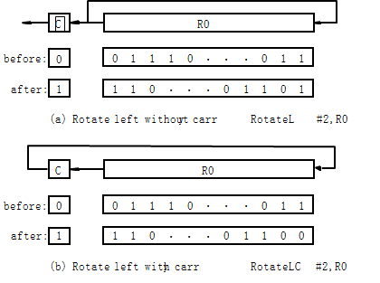
Rotate
‹#›
Notes:
‹#›
‹#›
*
MITE

Slide 92
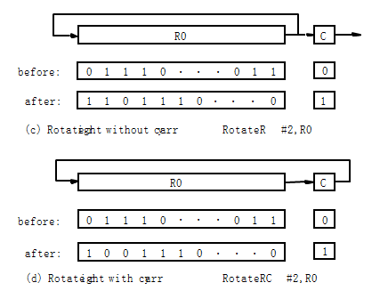
Rotate
‹#›
Notes:
‹#›
‹#›
*
MITE

Slide 93
Encoding of Machine Instructions
‹#›
Notes:
‹#›
‹#›
*
MITE

Slide 94
Encoding of Machine Instructions
Assembly language program needs to be converted into machine instructions. (ADD = 0100 in ARM instruction set)
In the previous section, an assumption was made that all instructions are one word in length.
OP code: the type of operation to be performed and the type of operands used may be specified using an encoded binary pattern
Suppose 32-bit word length, 8-bit OP code (how many instructions can we have?), 16 registers in total (how many bits?), 3-bit addressing mode indicator.
Add R1, R2
Move 24(R0), R5
LshiftR #2, R0
Move #$3A, R1
Branch>0 LOOP
8
7
7
10
OP code
Source
Dest
Other info
(a) One-word instruction
‹#›
Notes:
‹#›
‹#›
*
MITE

Slide 95
Encoding of Machine Instructions
What happens if we want to specify a memory operand using the Absolute addressing mode?
Move R2, LOC
14-bit for LOC – insufficient
Solution – use two words
OP code
Source
Dest
Other info
Memory address/Immediate operand
(b) Two-word instruction
‹#›
Notes:
‹#›
‹#›
*
MITE

Slide 96
Encoding of Machine Instructions
Then what if an instruction in which two operands can be specified using the Absolute addressing mode?
Move LOC1, LOC2
Solution – use two additional words
This approach results in instructions of variable length. Complex instructions can be implemented, closely resembling operations in high-level programming languages – Complex Instruction Set Computer (CISC)
‹#›
Notes:
‹#›
‹#›
*
MITE

Slide 97
Encoding of Machine Instructions
If we insist that all instructions must fit into a single 32-bit word, it is not possible to provide a 32-bit address or a 32-bit immediate operand within the instruction.
It is still possible to define a highly functional instruction set, which makes extensive use of the processor registers.
Add R1, R2 ----- yes
Add LOC, R2 ----- no
Add (R3), R2 ----- yes
‹#›
Notes:
‹#›
‹#›
*
MITE

Slide 98
Subroutines
It is a subtask
CALL instruction
Store the contents of the PC in the link register
Branch to the target address specified by the instruction
RETURN instruction
Branch to the address contained in the link register
The way in which a computer makes it possible to call and return from subroutine – subroutine linkage
‹#›
Notes:
‹#›
‹#›
*
MITE

Slide 99
Subroutines
Memory Location | Calling Program | Memory Location | Subroutine
… | …
200 | CALL SUB | 1000 | First instruction
204 | Next instruction |  | …
208 | … |  | Return
PC New PC Value
Link
204
1000
204
‹#›
Notes:
‹#›
‹#›
*
MITE

Slide 100
Stack Frame
Location constitute a private work space for the subroutine
Created at the time the subroutine is entered and freed up when the subroutine returns
Frame Pointer – to access the local variables of subroutine
‹#›
Notes:
‹#›
‹#›
*
MITE

Slide 101
Useful Links
www.nptelvideos.in/2012/11/computer-organization.html
https://freevideolectures.com/course/2277/computer-organization
‹#›

