Slide 1

DEPT. OF CIVIL ENGG.
K.S. SCHOOL OF ENGG. & MANAGEMENT
NAME OF THE FACULTY: Dr Rashmi H R,
Asst. Prof
MODULE:1
SUBJECT: MUNICIPAL WASTEWATER ENGINEERING
SUBJECT CODE: 18CV55

Slide 2
TOPICS
NEED FOR SANITATION
METHODS FOR SEWAGE DISPOSAL
TYPES OF SEWAGE SYSTEM
DRY WEATHER FLOW
WET WEATHER FLOW
FACTOR AFFECTING DRY WEATHER FLOW AND WET WEATHER FLOW

Slide 3
NEED FOR SANITATION
Proper disposal of human excreta to safe place before it starts decomposing and cause insanitary conditions.
To take out all kinds of wastewater immediately ,so that mosquitos , bacteria etc , should not breed in it.
Final disposal of sewage on land or in nearby waterbodies should be treated , so that receiving land or water may not get polluted for further use.

Slide 4
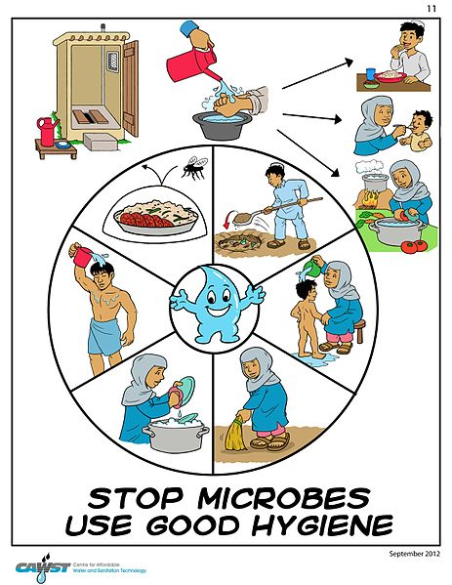

Slide 5
METHODS OF SEWAGE DISPOSAL
There are two types of methods of sewage
disposal are;
1] CONSERVANCY SYSTEM
2] WATER CARRIAGE SYSTEM

Slide 6
CONSERVANCY SYSTEM
In this system types of refuse and storm water is collected , conveyed and disposed separately by various methods .
This method was in practice in ancient times .
In present also this method is in practice in small towns , villages etc …..

Slide 7
ADVANTAGES OF CONSERVANCY SYSTEM
Initial cost is low .
The quality of sewage reaching at the treatment before disposal is low .
DISADVANTAGES OF CONSERVANCY SYSTEM
Possibility of storm water may mix with sewers and cause heavy load on treatment plant .
In crowded lanes it is difficult to provide two different sewers .
Decomposition of sewage may cause insanitary conditions and dangerous for human health .

Slide 8
WATER CARRIAGE SYSTEM
In this system , the excremental matters are mixed up in large quantity of water and are taken out of the city through proper drainage system and disposed off after necessary treatment .
The sewage consists of 99.9% of water and 0.1% of solids.
This system is universally used now a days .

Slide 9
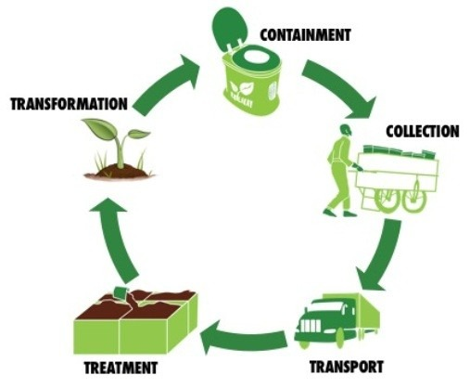

Slide 10
ADVANTAGES OF WATER CARRIAGE SYSTEM
It is hygienic method because all excremental matters are collected and disposed by water.
Less space is occupied as only one sewer is laid .
The land required for disposal work is less as compared to conservancy system .
DISADVANTAGES OF WATER CARRIAGE SYSTEM
This system is very costly in initial cost.
The maintainance of system also very costly .

Slide 11
TYPES OF SEWER SYSTEM
Separate system
Combined system
Partially separate system

Slide 12
SEPARATE SEWER SYSTEM
In this system two sets of sewers are laid for drainage and sewage.
Drainage and sewage are taken independently of each other through these two different sets of conduits.
The sewage is carried to the treatment plant and storm water is disposal of to water

Slide 13
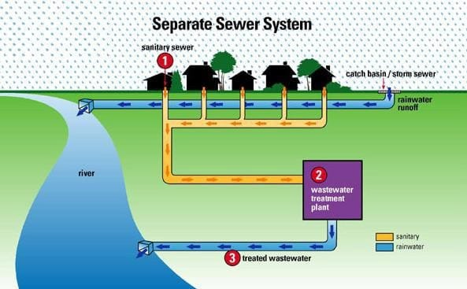

Slide 14
COMBINED SYSTEM
In this system only one set of sewers are used to carry both sanitary sewage and surface water.
Sewage and storm water both are carried to the treatment plant through combined sewers.

Slide 15
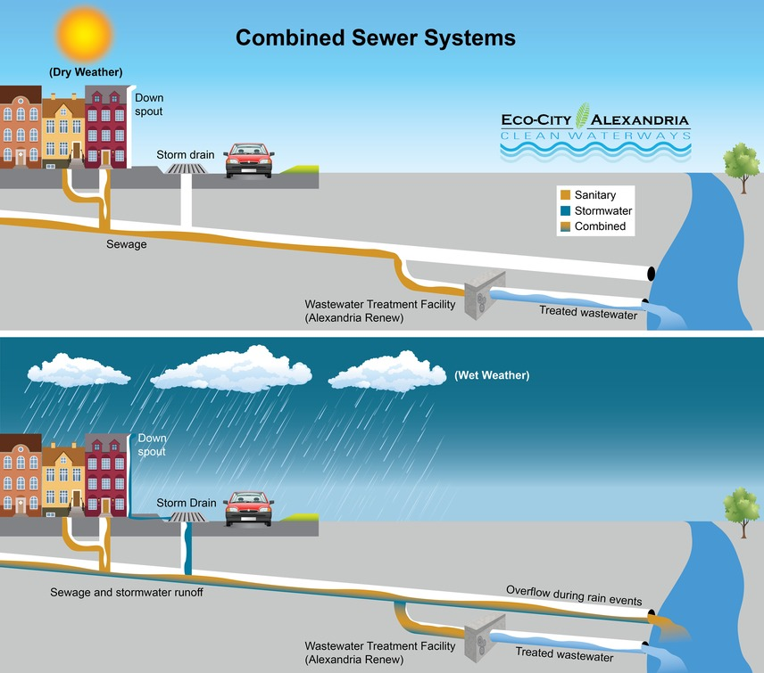

Slide 16
PARTIALLY SEPARATE SYSTEM
A portion of storm water during rain such that the water originating from roof tops and paved courtyards is allowed to enter sanitary sewer to treatment plants. Thus by diluting the waste concentration

Slide 17
DRY WEATHER FLOW
It is the quantity of water that flows through a sewer in dry weather when no storm water is in the sewer.
It is also known as sanitary sewage.

Slide 18
SOURCES
Domestic waste water: the waste water reaching sewer due to domestic activities such as bathing, washing clothes and vessels etc.
Industrial waste water: the waste water generated due to manufacturing process in industries .
Waste water from public facilities: that is the waste water generated from school, cinemas , hotels etc.
ground water infiltration: infiltration of gw depends upon the nature of soil, materials of sewer, nature and condition of sewer joints, depth of sewer

Slide 19
WET WEATHER FLOW
The amount of rain water flowing over the ground surface, pavements , house roofs etc..,is commonly known as runoff or storm water.
this storm water is ultimately drained through the sewer ;the amount of peak storm water flow is several times more than of DWF.
This storm water flow is also known as wet weather flow

Slide 20
FACTOR AFFECTING THROUGH DWF
Rate of water supply: the quantity of used water discharged into sewer system is little less than the amount of water supplied to community.
Population growth: the quantity of sanitary sewage directly depends on the population .
Type of area served: if the area served is residential, the waste water produced is assumed to be equal to 70 % to 80 %
Infiltration of ground water: infiltration of water into sewer through joints increases the quantity of sewage

Slide 21
FACTOR AFFECTING THROUGH WWF
Catchment area
Ground slope
Permeability of ground
Extent of vegetation growth
Rainfall intensity
Rainfall duration
Condition of ground prior to rainfall
Concentration of catchment area
Climatic condition such as wind, temperature , humidity etc..,

Slide 22
Useful link
https://www.youtube.com/watch?v=YegffvYy8OY&list=PLq46p_ppqQemlLzkiMgKtPkkLWOKgN1kT
https://www.youtube.com/watch?v=zVZ9c6EXfTA
https://www.youtube.com/watch?v=We9BvA814gk

