Slide 1

MODULE:3
LEVELLING
SUBJECT: BASIC SURVEYING
SUBJECT CODE: 18CV35
DEPT. OF CIVIL ENGG.
K.S. SCHOOL OF ENGG. & MANAGEMENT
NAME OF THE FACULTY: SHASHI PRASAD N,
Asst. Prof.

Slide 2
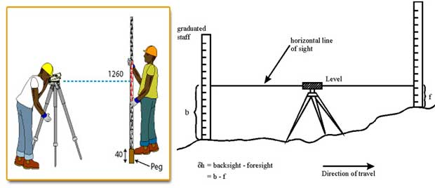
MODULE:3 LEVELLING
Basic terms and definitions, Methods of leveling, Dumpy level, auto level, digital and laser levels. Curvature and refraction corrections. Booking and reduction of levels. Differential leveling, profile leveling, fly leveling, check leveling, reciprocal leveling.

Slide 3
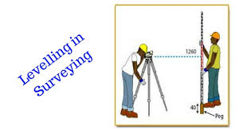
LEVELLING
Leveling is the art of determining the relative heights of different points on or below the surface of the earth.
The elevation of a point is the vertical distance above or below a reference surface called datum.
The datum commonly used is the mean sea level (M.S.L). There for leveling deals with the measurements in a vertical plane.
The data obtained from the process of leveling will be useful in the following two perspective:
Establish points for various engineering purposes had decided elevation with respect to a given datum.
To workout the elevation of given objects relative to each other or with respect to a given datum.

Slide 4
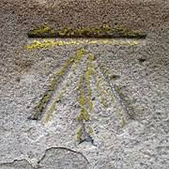
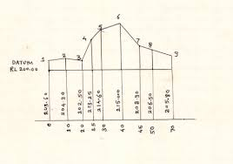
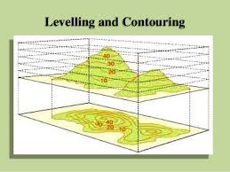
OBJECTS OF LEVELLING
To determine the relative height of different object on or below the surface of the earth.
To fix benchmarks.
To find profile of a road or railway or canals etc.
To show the contour of area.

Slide 5
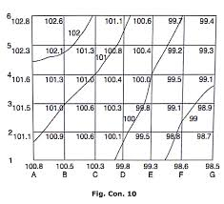
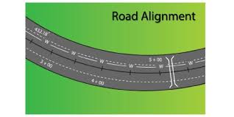
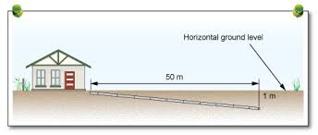
USES OF LEVELLING
For preparing contour map to fix sites for reservoir, dams , barrages, etc.
For fixing the alignment of roads, railways, irrigation canals, etc.
For determining the reduced levels of different points on or below the surface of the earth .
For plotting a longitudinal section and cross sections of a project in order to determine the volume of earth work.
To prepare a layout map for water supply, sanitary or drainage connections.
To estimate the reservoir capacity.
For setting out grades for sewers, etc.

Slide 6
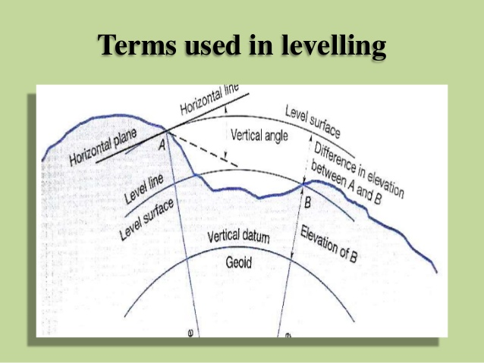
BASIC DEFINITIONS
Level surface: A level surface is any surface parallel to the mean spheroidal surface of the earth.
Level line : A level line is a line lying in the level surface. it is, therefore , normal to the plumb line at all points. As the level surface is a cold surface, the level line is also curve.
Horizontal plane: It is a plane tangential to the level surface at a point. It is also perpendicular to the direction of gravity.
Horizontal line: It is a straight line lying in the horizontal plane . It is tangential to the level line and perpendicular to the vertical line at that point.

Slide 7
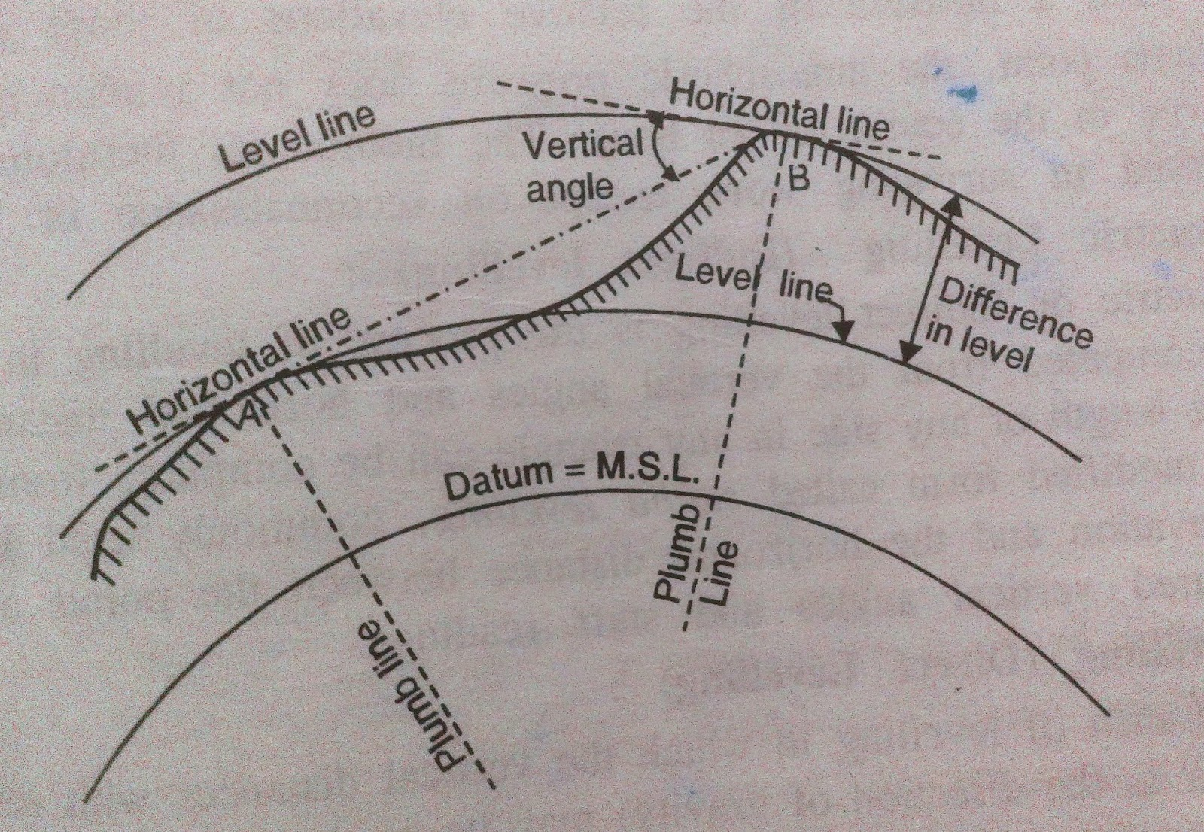
BASIC DEFINITIONS
Vertical line or Plumb line: It is a line indicated by are freely suspended plum bob. It is the line along the direction of gravity.
Vertical plane: Any plane passing through the vertical line is known as the vertical plane.
Vertical angle: The angle formed by the intersection of two lines in a vertical plane is known as a vertical angle.
Datum surface or Datum line: This is an imaginary level surface or level line from which the vertical distance of different points are measured. The datum commonly used this means sea level.
Mean Sea level [M.S.L]: The average height of the sea for all stages of the tides is known has mean seed level.

Slide 8
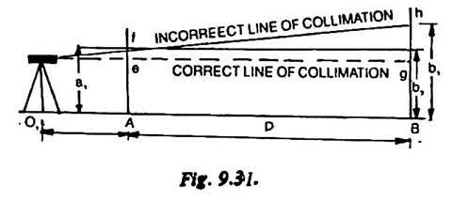
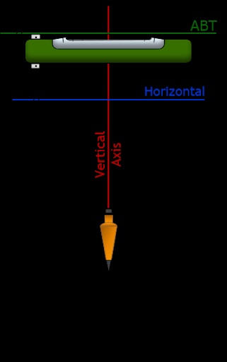
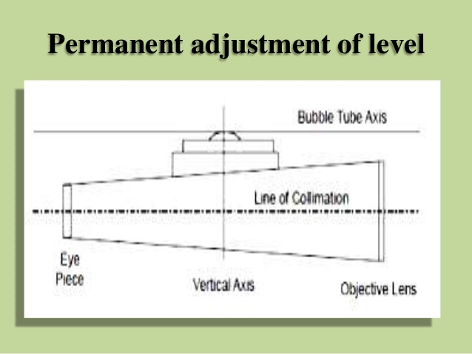
BASIC DEFINITIONS
Reduced level [R.L]: The vertical distance of a point above or below the datum line is known has reduced level of that point. The reduce level of a point may be positive or negative according as the pointers above or below the datum.
Line of collimation: It an imaginary line passing through the intersection of the crosshairs add the diaphragm and the optical center of the object class and its continuation. It is also known as the line of sight.
Axis of the telescope: This axis is an imaginary line passing through the optical center of the object glass and the optical center of the eyepiece.
Axis of bubble tube: It this an imaginary line tangential to the longitudinal curve of the bubble tube at its middle point.
Benchmarks [B.M]: It is a fixed reference point of known elevation. This cell has reference point for finding the reduced level of new points or for conducting leveling operations in project involving roadways, railways etc.

Slide 9
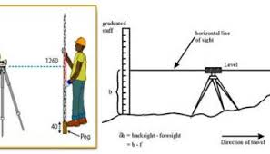
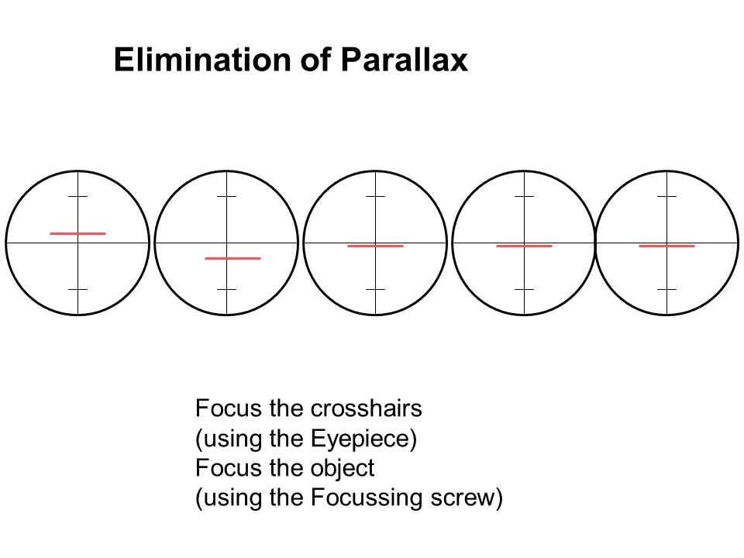
BASIC DEFINITIONS
Focusing: The operational setting the eye piece and the object class a proper distance apart for clear vision of the object is known as focusing. This can be done by turning the focusing screw clockwise or anticlockwise.
Station: In leveling, a station is that point where the leveling staff is held . It is the point whose elevation is to be determined or established for a given elevation.
Balancing of sights: When the distance of the points where back sight and foresight our speaker, kept approximately equal, it is known as balancing of sights. this is done to minimize the effect of instrumental and other errors.
Sensitiveness of a level tube: It is used to indicate the angular value of 1 division marked on the tube. Thus, the greater the moment of bubble for a given change in the angle, the more sensitivity is the tube.
Parallax: It is the apparent movement of the image related to the crosshairs when the image formed by the object does not fall in the plane of the diaphragm.

Slide 10
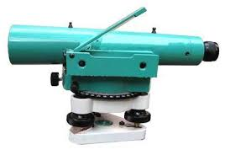
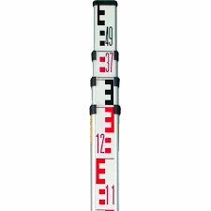
INSTRUMENTS USED IN LEVELLING
The following are the instruments used for levelling:
A Level
A levelling Staff
A Level:
The purpose of a level is to be provide a horizontal line of sight. Essentially a level consists of the following four parts:
A telescope to provide with line of sight.
A level tube to make the line of sight horizontal.
A levelling head to bring the bubble in its centre of run.
A tripod to support the instrument.

Slide 11
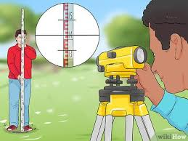
DUMPY LEVEL
It is a commonly used levelling instrument. It is a simple, compact and stable levelling instrument.
The earlier times dumpy level was much shorter and thicker than the other types of levels and hence it was known as dumpy levels.
A dumpy level is most suitable when from one setting of the instrument, elevations of several points are to be determined.
This level consists of a telescope, a vertical spindle, a level tube and a levelling head.
The telescope tube and the vertical spindle are rigidly fixed and cast as one piece.
The spindle revolves in the socket of the levelling head.
The levelling head consists of two parallel plates kept at a distance apart by three or four levelling foot screws.
The telescope can be rotated in horizontal plane about its vertical axis.
The telescope may be internal or external focusing type.
A sensitive level tube is fitted on the top of the telescope or on one of its side.
An inclined mirror is attached to the level tube to enable the observer to view the bubble from the eyepiece end.
The bubble us brought to the centre by using the foot screws. The sensitivity of the bubble tube is generally 20” per mm.

Slide 12
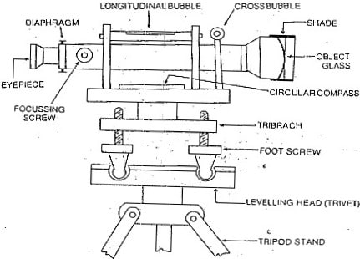
DUMPY LEVEL
In the modern dumpy levels, the instrument is provided for a small lateral movement of the telescope.
A graduated circle is also provided to determine the direction of the telescope.
The size of the dumpy level is usually defined by the focal length of the object glass.
Advantages of Dumpy Level:
It is simple in construction with a few movable parts.
It requires fewer permanent adjustments.
Adjustments once carried out remain for a longer period.

Slide 13
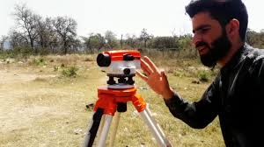
AUTO LEVEL
It is a level which contains an optical compensator which maintains a level line of collimation even though the instrument may be tilted as much as 15 minutes of arc.
In conventional leveling instrument, the line of collimation is made horizontal by means of long bubble tube.
This is a time-consuming job.
In such a conventional instrument if the bubble is not in the centre if its run, the vertical axis will not be truly vertical, and the line of collimation will be tilted instead of being horizontal.

Slide 14
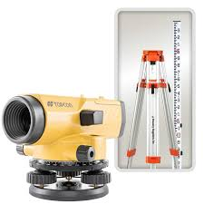
AUTO LEVEL
In auto level, spirit bubble is no longer required to set a horizontal line of collimation.
In such a level, the a system of compensators which ensure that the line of sight viewed through the telescope is horizontal even if the optical axis of the telescope tube itself is not horizontal.
A circular bubble is used to level the instrument approximately 15’ of the vertical, either with the help of foot screw arrangements or a quickest device.
An automatic or auto level is also known as self levelling or pendulum level.

Slide 15
AUTO LEVEL
In auto level, spirit bubble is no longer required to set a horizontal line of collimation.
In such a level, the a system of compensators which ensure that the line of sight viewed through the telescope is horizontal even if the optical axis of the telescope tube itself is not horizontal.
A circular bubble is used to level the instrument approximately 15’ of the vertical, either with the help of foot screw arrangements or a quickest device.
An automatic or auto level is also known as self levelling or pendulum level.

Slide 16
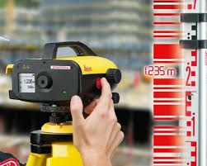
DIGITAL LEVEL
A digital electronic level is also set level on a tripod and reads a bar-coded staff using electronic laser methods.
The height of the staff where the level beam crosses the staff is shown on a digital display.
This type of level removes interpolation of graduation by a person, thus removing a source of error and increasing accuracy.
During nighttime, the dumpy level is used in conjunction with an auto cross laser for accurate scale readings.

Slide 17
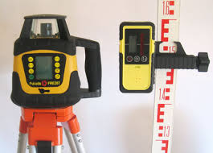
LASER LEVEL
A rotary laser level is a more advanced laser level in that it spins the beam of light fast enough to give the effect of a complete 360 degree horizontal or vertical plane, thus illuminating not just a fixed line, but a horizontal plane.
The laser beam projector employs a rotating head with a mirror for sweeping the laser beam about a vertical axis.
If the mirror is not self-leveling, it is provided with visually readable level vials and manually adjustable screws for orienting the projector.
A staff carried by the operator is equipped with a movable sensor, which can detect the laser beam and gives a signal when the sensor is in line with the beam (usually an audible beep).
The position of the sensor on the graduated staff, also known as a grade rod, or story pole, allows comparison of elevations between different points on the terrain.
Most laser levels are used in the construction industry.

Slide 18
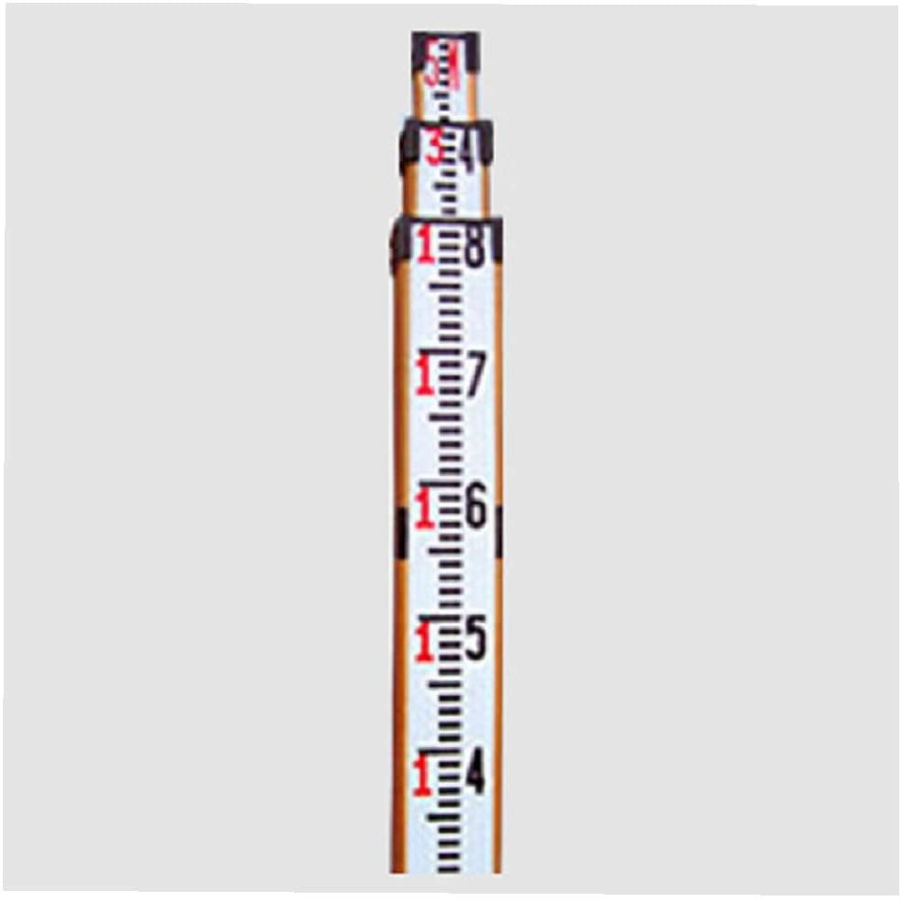
LEVELLING STAFF
A levelling staff is a straight rectangular rod and having graduations painted on its surface. It is also known as level rod.
The length of levelling staves in common use are 2m, 3m, 4m and 5m.
Levelling staves are made of aluminum alloys are also available.
The purpose of using levelling staff is to determine the elevation of a point on ground above or below the line of collimation.
There are two types of levelling staff:
Self-Reading Staff.
Target Staff.

Slide 19
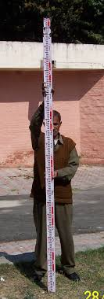
SELF- READING LEVELLING STAFF
Readings can be taken easily and faster.
The observer reads and records the staff reading.
Inexperienced person can be employed to hold the staff as holding the staff to plumb is only required.
Accuracy in reading is limited

Slide 20
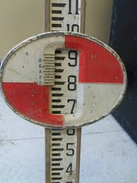
TARGET LEVELLING STAFF
Readings cannot be taken easily as the target is to be adjusted to coincide with the line of sight
The staff man adjusts the target, reads and records the staff reading.
Experienced and trained staff are employed to: Keep the target staff in plumb. Adjust the target. Read and record the target vernier.
Accuracy is greater as vernier is used.

Slide 21
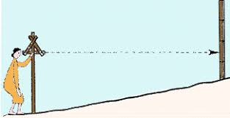
DIRECT LEVELLING
This method is also known as spirit leveling and it is the most commonly used method of leveling.
The method employed spirit level and telescope to measure the vertical distance on the leveling staff placed on various points.

Slide 22
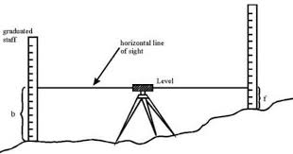
DIRECT LEVELLING: SIMPLE LEVELLING
This is used to find out the difference in elevation of two points which are visible from a single position of the level.
It is only suitable when the distance involved is within the site range of the level.
When the difference of level between two points is determined by setting the level instrument midway between the points, the process is called simple leveling.

Slide 23
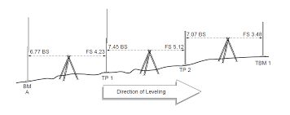
DIRECT LEVELLING: DIFFERENTIAL LEVELLING
It is the method of leveling which requires more than one setting of the instrument to determine the difference in level between two points which are quite distance apart.
This method is also used when the difference in elevations is large or there are intervening obstacles, and the levels could not be found from a single setup of the instrument.
This method can be adopted when:
The points are at greater distance apart.
There are obstacles between the points.
The difference in elevation is too large.
One setting of the instrument will be inadequate.

Slide 24
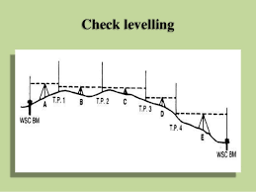
DIRECT LEVELLING: CHECK LEVELLING
It is carried out for the purpose of checking of elevations which have already been determined.
Generally, check level is done at the end of each day's work from last station to the starting station for checking the day’s work.

Slide 25
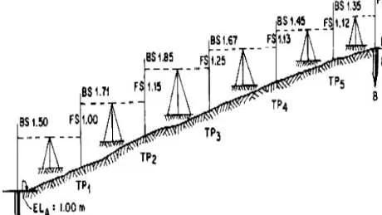
DIRECT LEVELLING: FLY LEVELLING
When a benchmark of a known elevation is available, a series of levels maybe run a longer general direction to read some other point whose level can be determined and fixed as a temporary benchmarks some the method is called fly Leveling.
It is also employed for the determination of approximate levels of different point.
This method is done very rapidly but low precision is required.
It is normally used for recognizing surveys or for approximate checking of the levels.

Slide 26
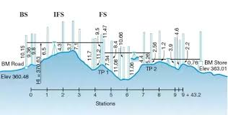
DIRECT LEVELLING: PROFILE LEVELLING
The operation of taking levels along the centerline of any alignment at regular intervals is known has Longitudinal leveling.
In this operation, the backsight, intermediate sight and ore sight reading are taken at regular intervals, at every setup of the instrument.
It is used in route surveys such as highway, railway, canal, sewer line. the object is to determine the profile of the ground in a vertical longitudinal section.

Slide 27
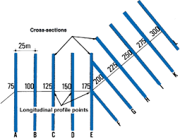
DIRECT LEVELLING: CROSS SECTIONAL LEVELLING
The operation of taking levels transverse to the direction of longitudinal leveling, is known as cross sectional leveling.
The cross section are taken at regular intervals along the alignment.
This leveling is done in order to know the nature of the ground across the centerline of any alignment.

Slide 28
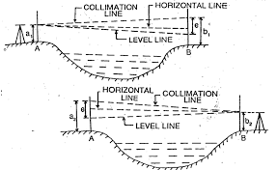
DIRECT LEVELLING: RECIPROCAL LEVELLING
It is the accurate determination of the difference in level between two points by setting up the instrument near each of the points in succession and taking observations of staff readings on both.
It is useful when it is not feasible to set up the level midway between the points.

Slide 29
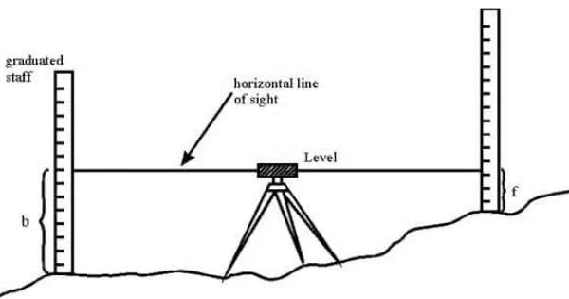
DIRECT LEVELLING: PRECISE LEVELLING
This is a very accurate method of differential leveling for establishing benchmarks or where high precision is required.
Refine instruments and procedure enhance the accuracy of the work for stop it is a specialized form of leveling and is usually conducted by government agencies like survey of India.

Slide 30
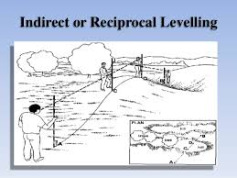
INDIRECT LEVELLING
In case of the methods of the indirect levelling, the relative levels of the points are found out by the indirect observations

Slide 31
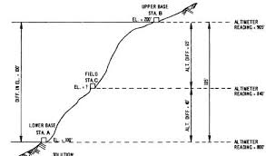
INDIRECT LEVELLING: BAROMETRIC
The principle that atmospheric pressure varies inversely with the altitude of a point is applied in case of barometric levelling.
A barometer is therefore used in this method and the readings observed at different points give a measure of the relative elevation of those points.
The process of barometric levelling gives approximate results and it is therefore adopted in the reconnaissance of preliminary survey.

Slide 32
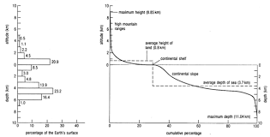
INDIRECT LEVELLING: HYPSOMETRY
In this, the temperature at which the water boils is taken as the basis for determining the height of the point.
As the altitude increases, the atmospheric pressure decreases and due to this, the boiling point of water is lowered.

Slide 33
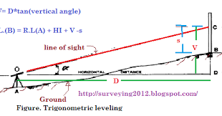
INDIRECT LEVELLING: TRIGNOMETRY
In this case , the relative elevations of the different stations are worked out by taking the vertical angles and measuring or computing the horizontal distances.
The vertical angles are measured by means of theodolite. The main advantage of this method is that it brings down the number of the change points to a minimum even though the difference in level at two points is very great.

Slide 34
USEFUL WEBLINKS
https://youtu.be/4WJQiIUtfGo
https://youtu.be/v1jKEfcbp8o
https://youtu.be/lVVbF1M198Q

